Slide 1
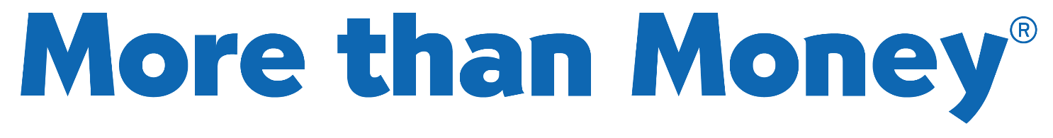


Slide 2
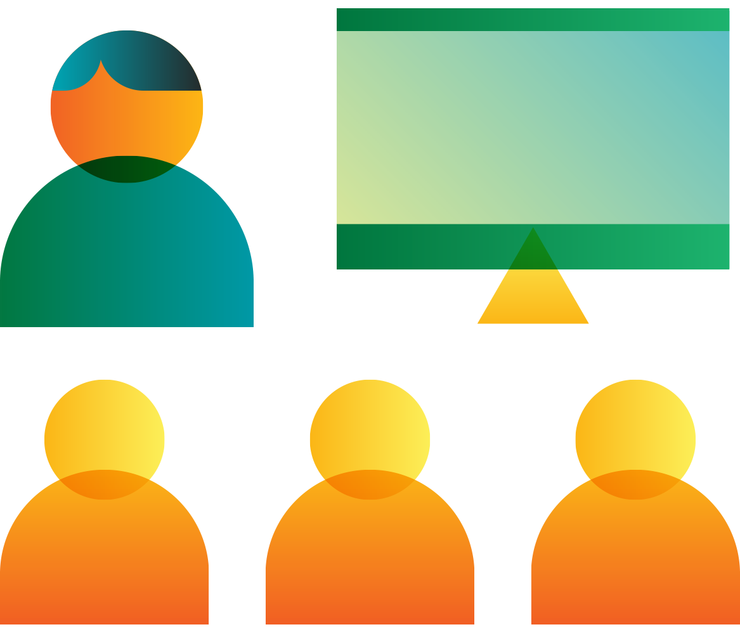
Introduction
Name
Background
Skills, talents, interests
Volunteering for JABC
Tent Cards
Preparation Portfolios
This program is provided by
JA British Columbia (JABC), a member of JA Worldwide, the world’s largest not-for profit organization dedicated to educating youth about business.
Thanks to community volunteers, JABC delivers programs in
Financial Literacy, Work Readiness & Entrepreneurship free of charge to Grade 4 to 12 students across B.C.

Slide 3
Agenda
Lesson 1: The Money Garden
Lesson 2: Create a Business
Lesson 3: Build a Business
Lesson 4: Run a Business
Wrap Up

Slide 4
Lesson 1: The Money Garden

Slide 5
Objectives
Identify the role of money in everyday life
Explain the benefits of using a savings account

Slide 6
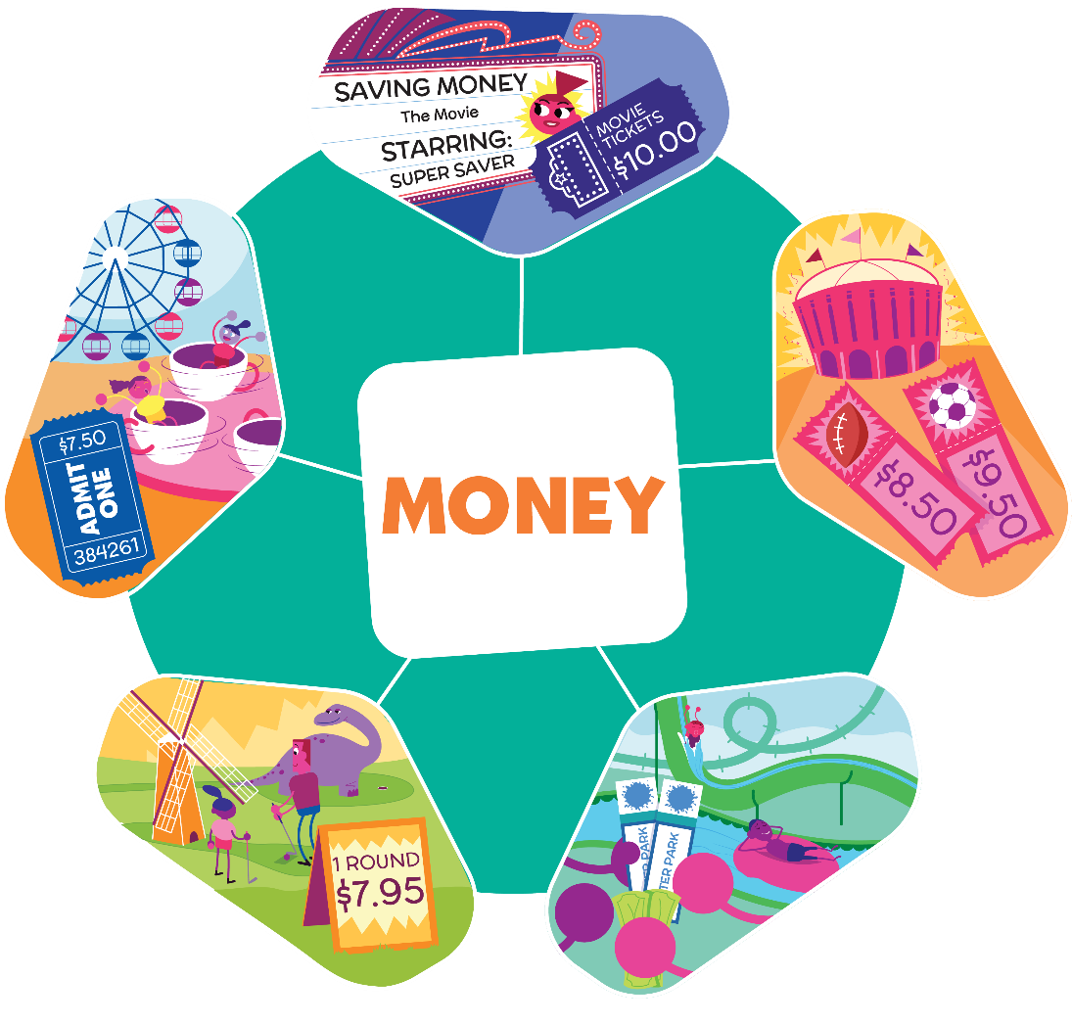
How do you think these are related?

Slide 7
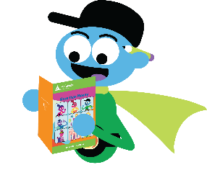
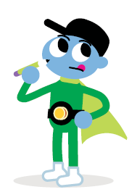
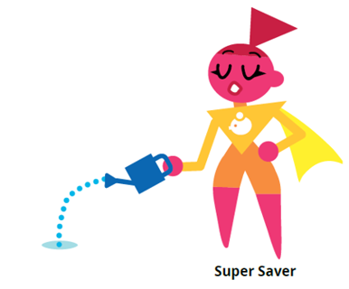
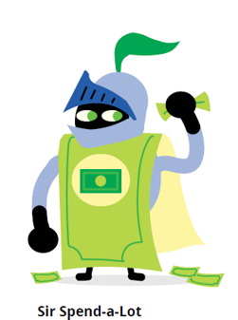
Our Money Helpers
Pg.3
Ernie the Earner
Super Saver
Sir Spend-a-Lot
Is a hard worker
Keeps money in a bank or credit union
Believes money must be:
  Earned
  Wisely saved and spent
Looks for new ways to save money
Knows money is important in life
  Thinks hard before spending it
“I’d buy that…and that…and that!”
Wants a money garden
Likes money
  Only wants to spend it

Slide 8
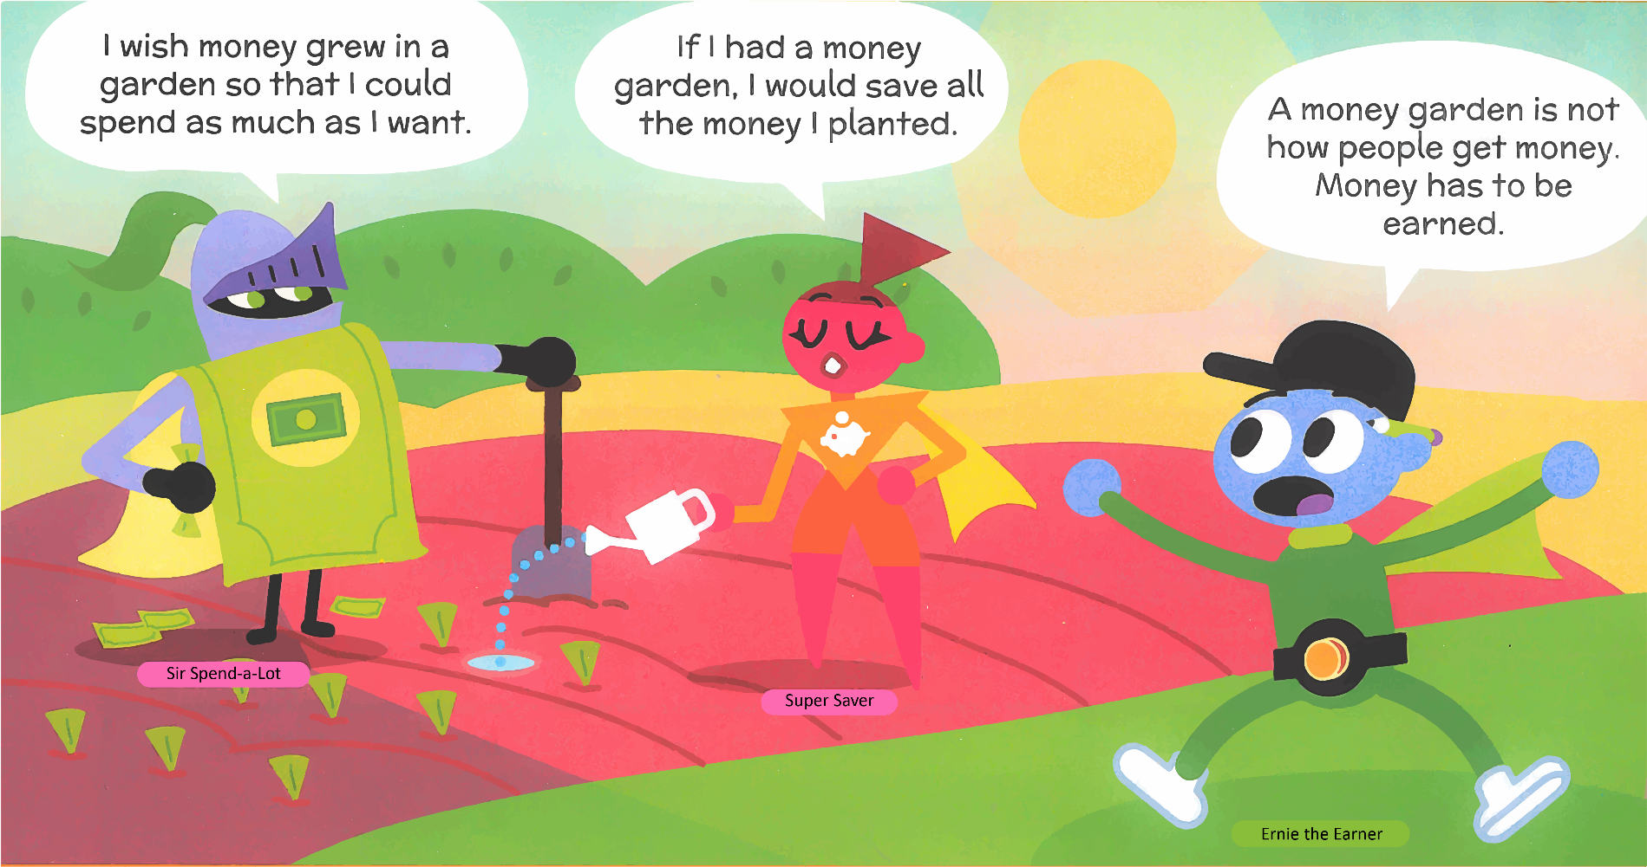
If money grew in a garden…
Pg.3

Slide 9
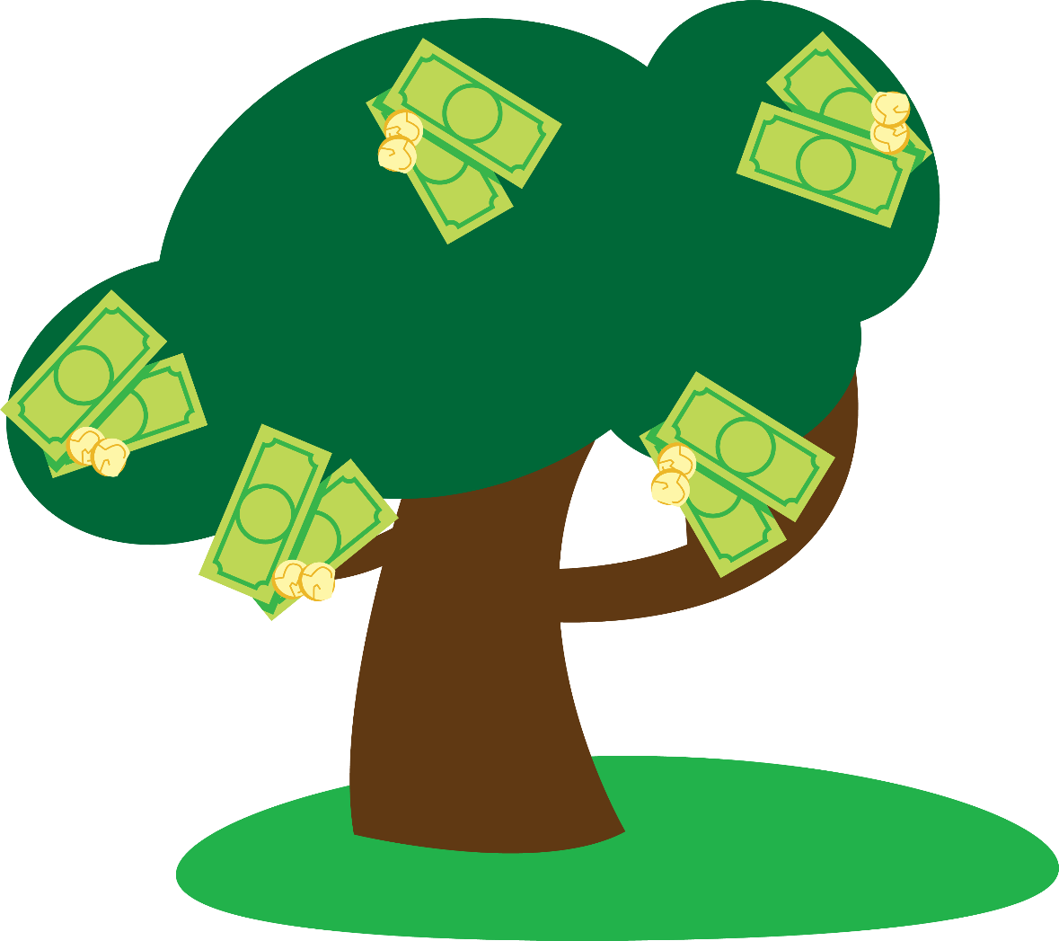
What if money grew in a garden?

Slide 10
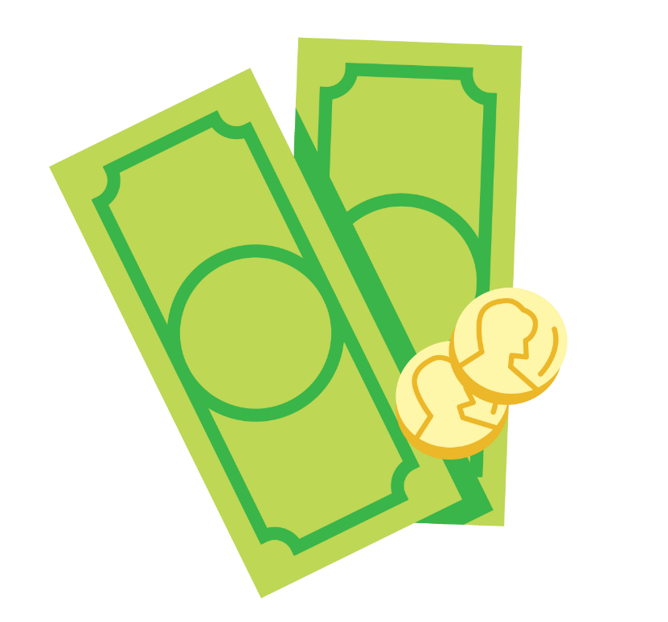
What is money?
Money
Any accepted payment
Notes:
Depending on Health & Safety Protocols:
The following slides may be used in place of using the printed Definition Cards provided.

Slide 11
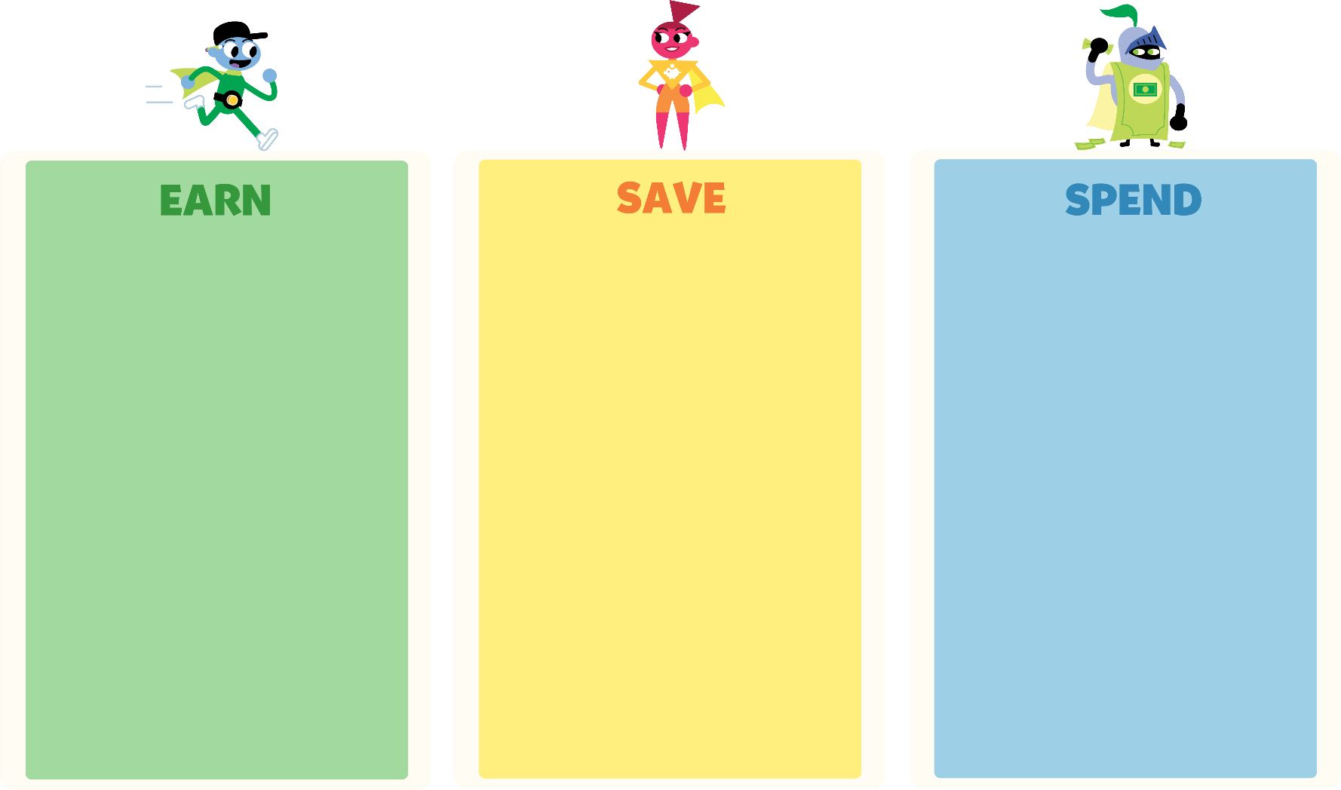
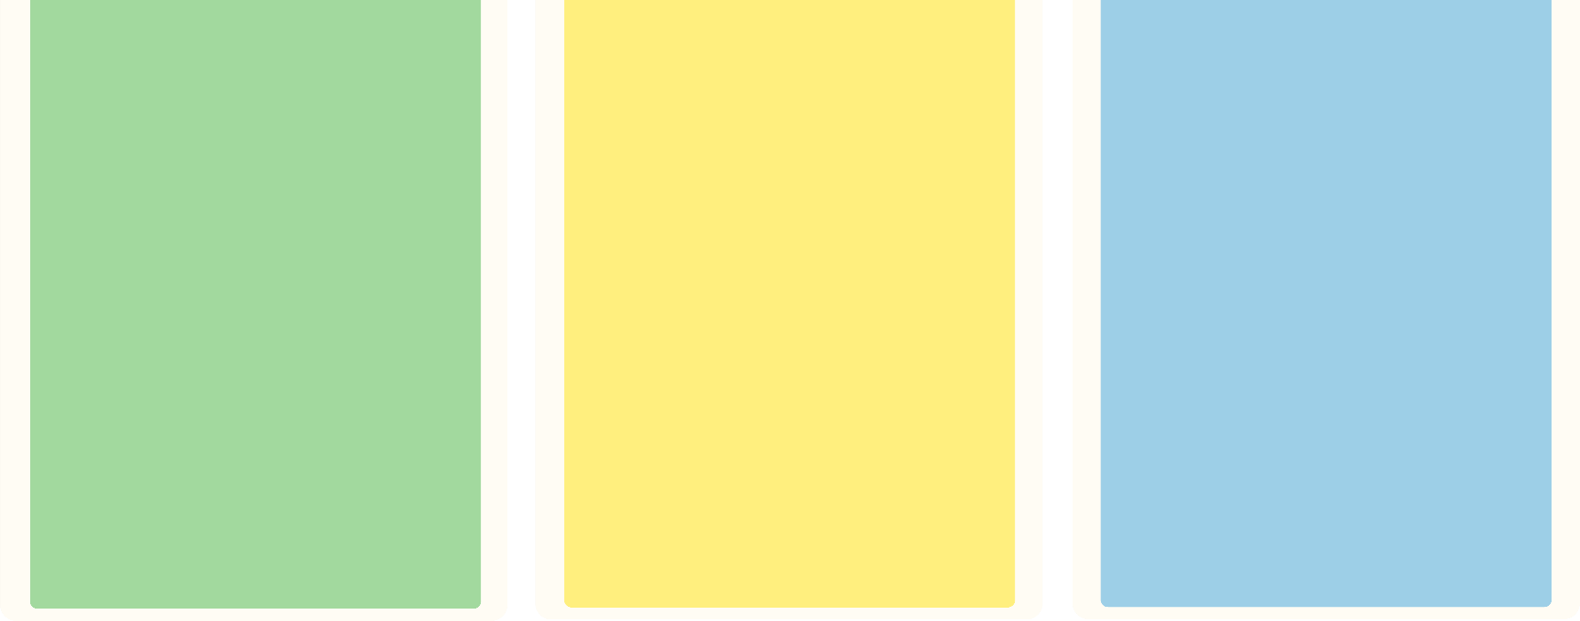
Something you can do to
make money
Something you would like to
save for
Something you
spent money
on recently
Notes:
Suggestion:
Distribute a piece of paper to each student or have them draw three equal boxes on the back side of their Preparation Portfolios and add Earn, Save, Spend at the top of each column.

Slide 12



How others use money
Financial Institution
Earn
Income
Receive income for labor or services
Money received as payment for work, goods, services or rent
A business that provides money-related services

Slide 13
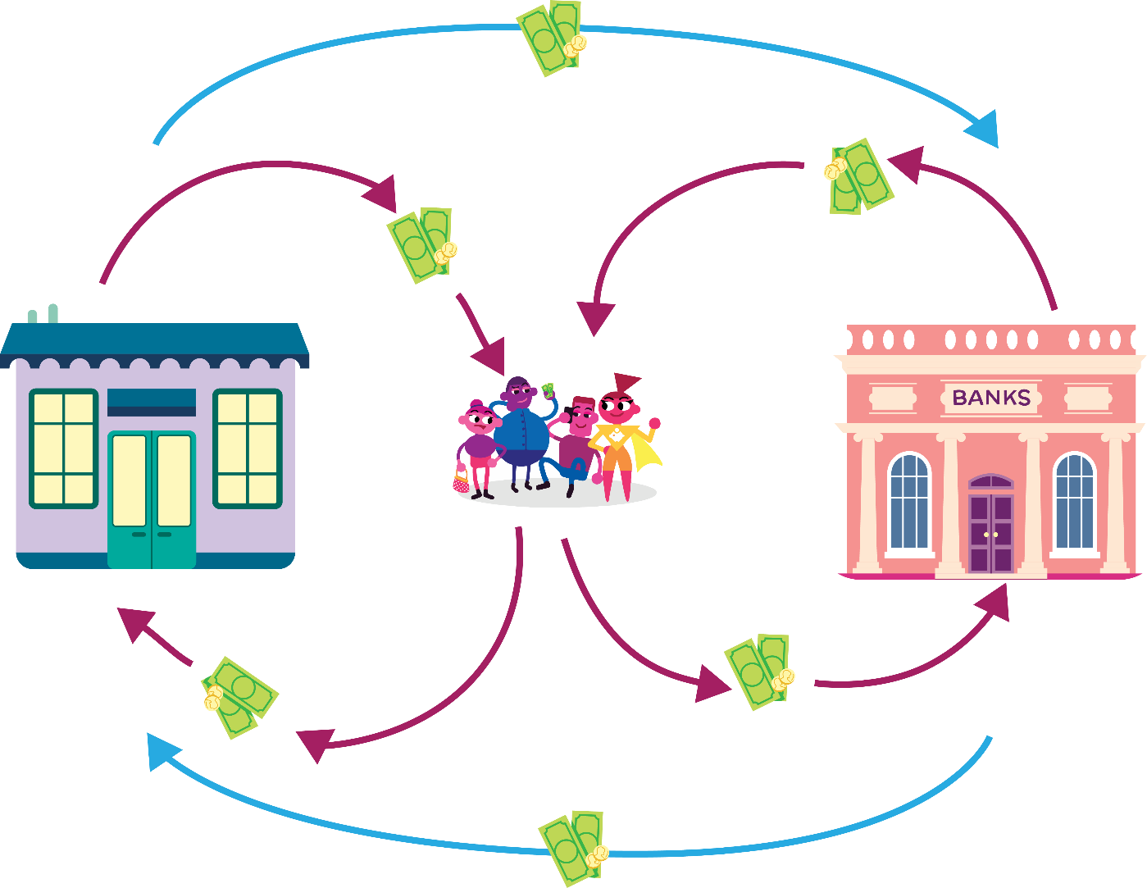
Money on the move
Pg.4
Businesses
People
Banks

Slide 14
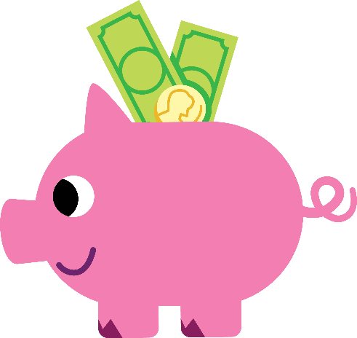

Earn, Save, Spend
Deposit
Savings Account
Withdrawal
Putting money in a bank account for safe keeping
Holds money for later
Taking money out of a bank account

Slide 15
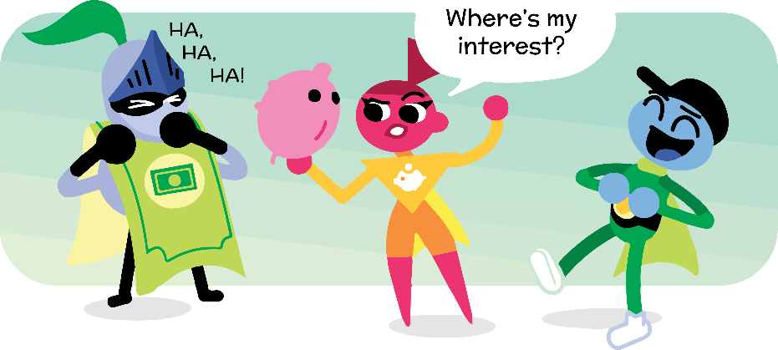
What is interest?
Interest
Money paid for using someone else’s money

Slide 16



Money Tracker
Pg.4
Notes:
JA Program videos are available in downloadable formats here: https://jabc.ca/classroom-presentations/
If the following video will not run on your device from this slide deck, then please visit this webpage to directly download the video and show the video to students from outside of this slide deck.

Slide 17
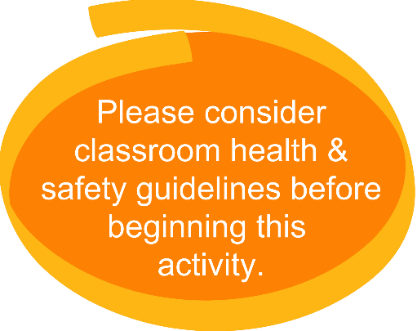
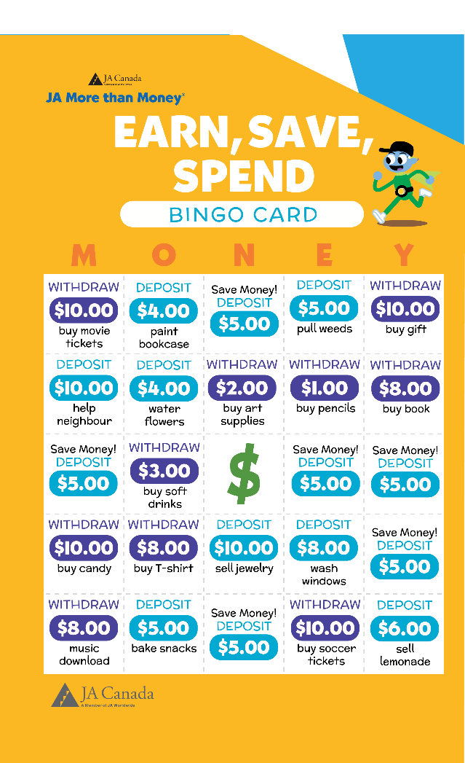
BINGO
Spaces will be called out
Use plastic chips or markers to cover the space
  Record in the money tracker at the same time
To win, get a line in any direction (horizontal, vertical, diagonal) and call BINGO!
Notes:
Depending on Health & Safety Protocols:
The host teacher should determine whether the game can be safely played or move on to the next activity.

Slide 18
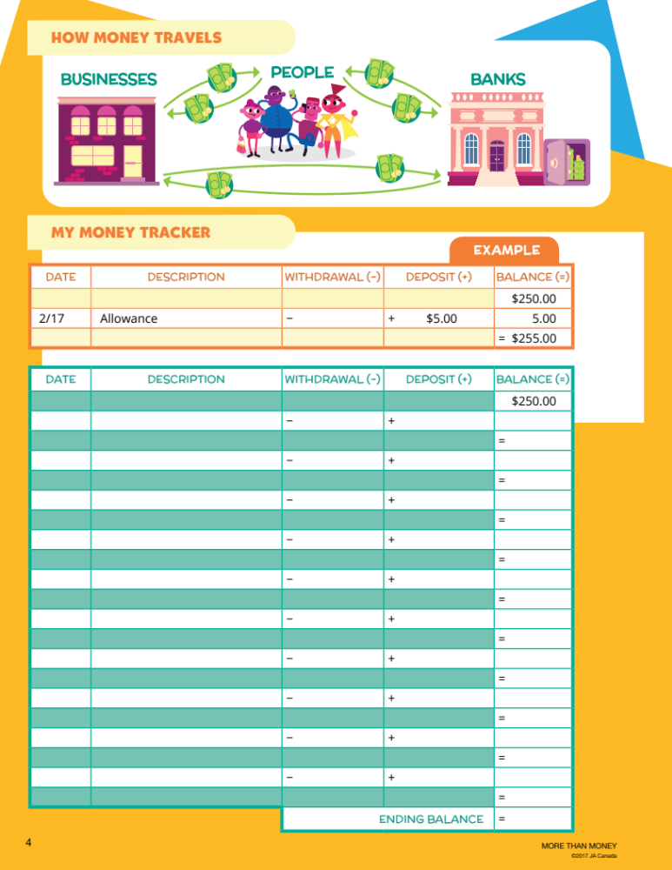
Let’s Start!

Slide 19
Summary and Review – Lesson 1
What is the role of money in everyday life?
What are the benefits of using a savings account?

Slide 20
Lesson 2: Create a Business

Slide 21
Objectives
Define business, goods and services
Identify businesses to start
Learn about entrepreneurs

Slide 22

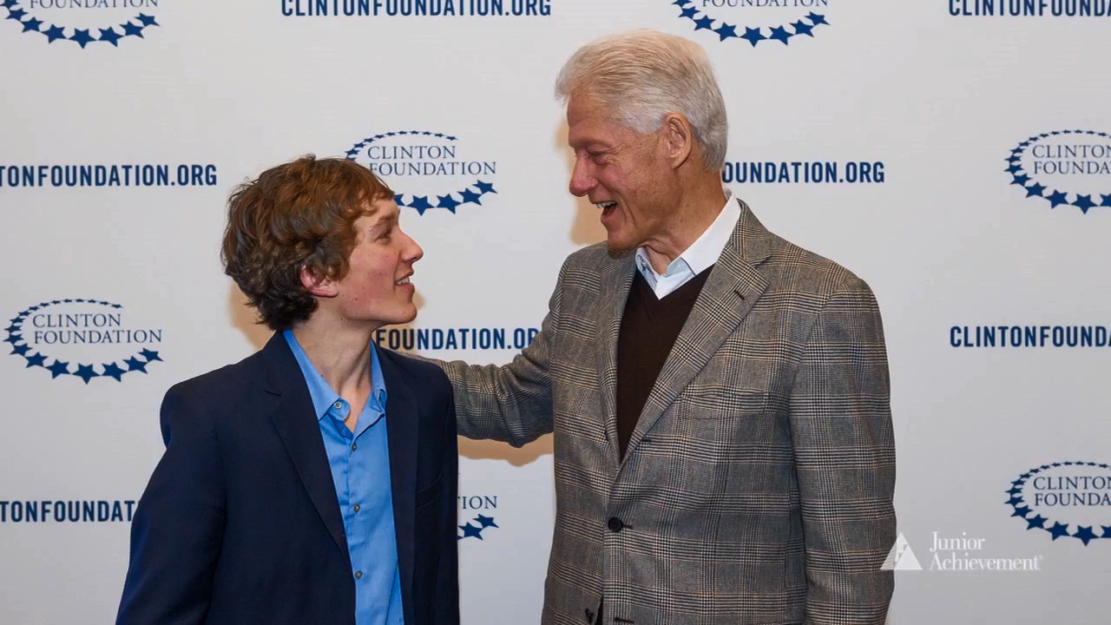
What are entrepreneurs?
Notes:
JA Program videos are available in downloadable formats here: https://jabc.ca/classroom-presentations/
If the following video will not run on your device from this slide deck, then please visit this webpage to directly download the video and show the video to students from outside of this slide deck.

Slide 23
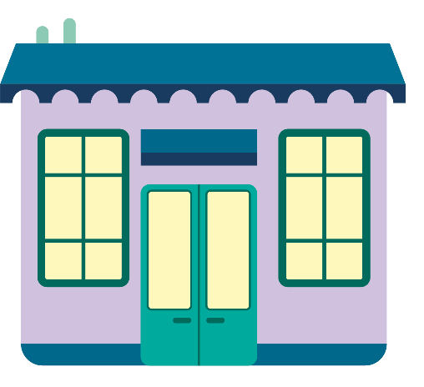
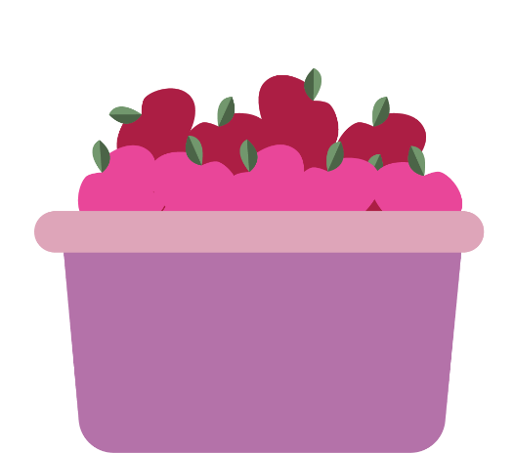
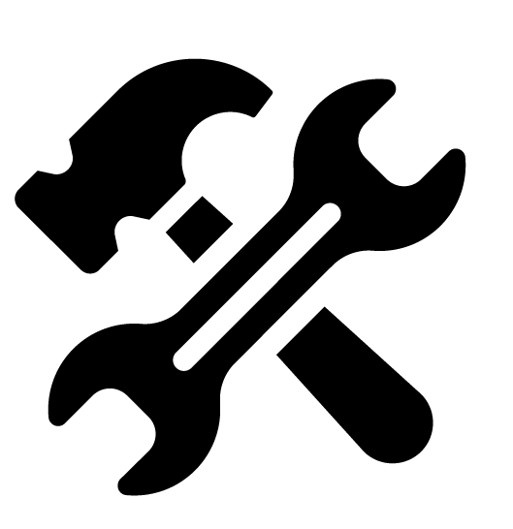
Business, Goods and Services
Business
Goods
Services
A company that makes or sells a product or service
Items that are bought and sold
Work done for others, such as cutting hair or repairing cars

Slide 24
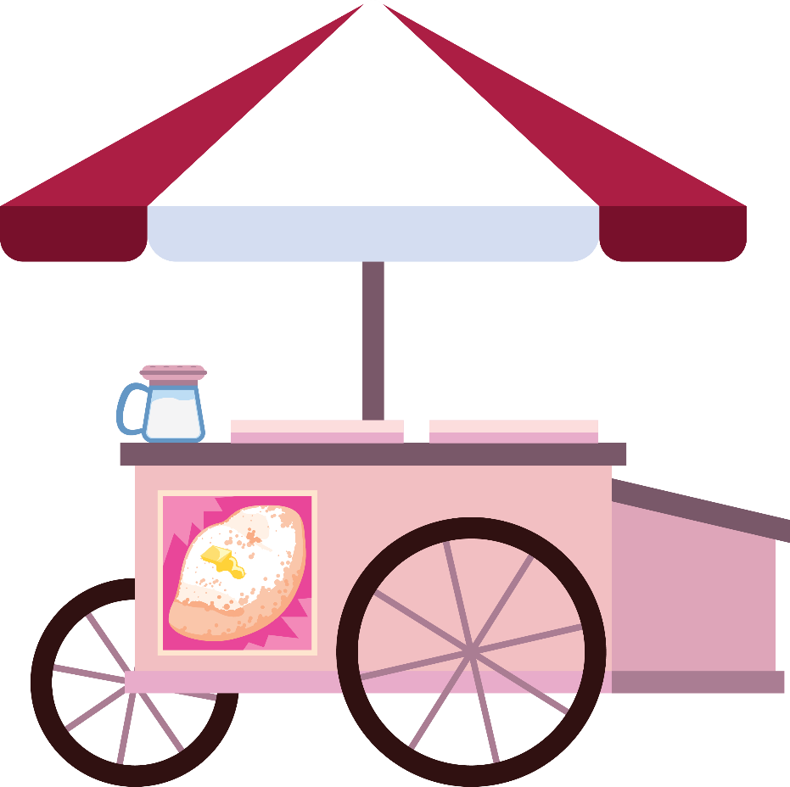
What is an entrepreneur?
Entrepreneur
A person who starts a business

Slide 25
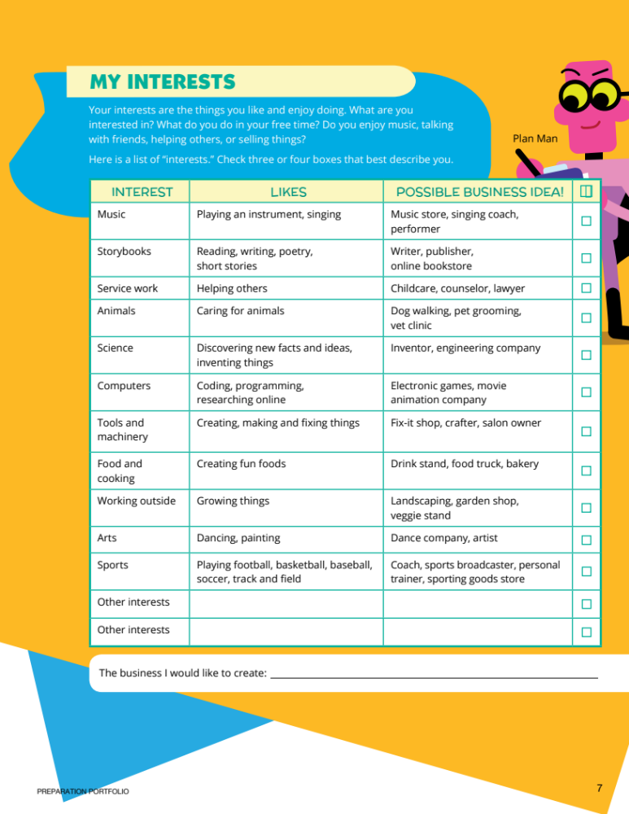
Select 3-4 Interests
Pg.7

Slide 26
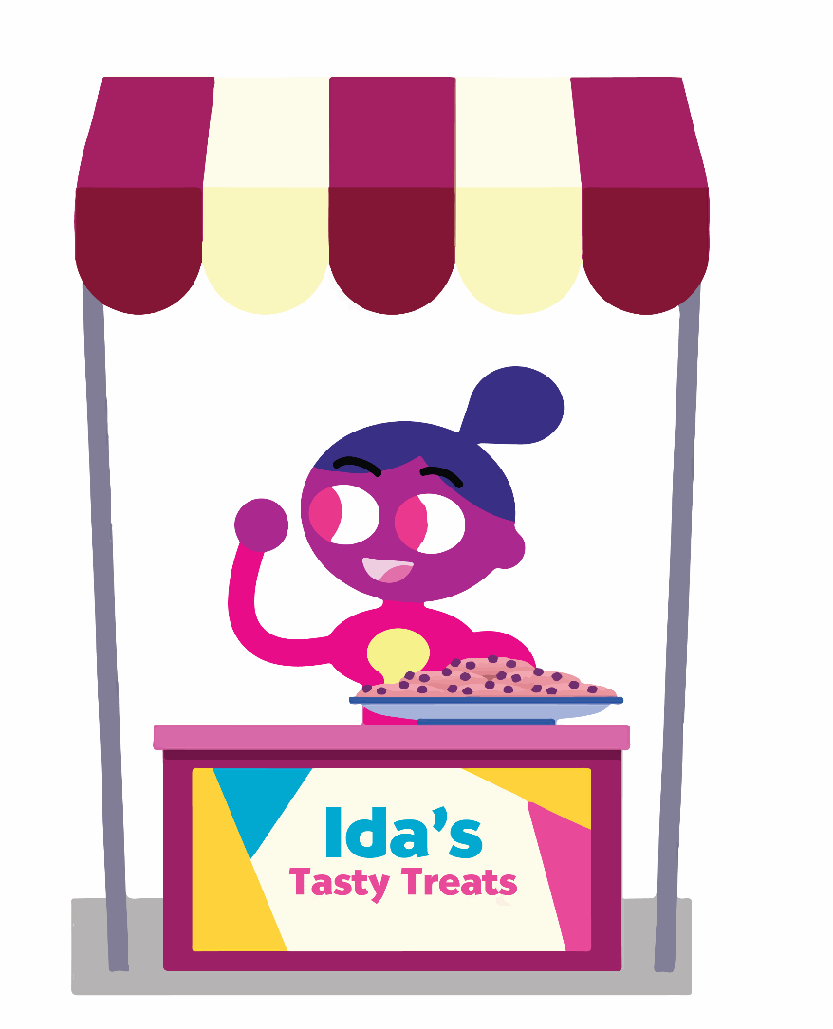
What are skills?
Pg.5
Skills
Things a person does well

Slide 27
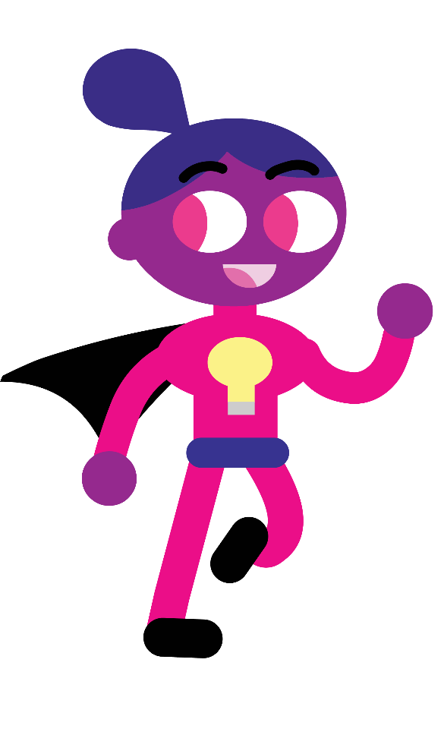
New character
Ida Idea
Entrepreneur
Lots of ideas
Knows how to run businesses

Slide 28
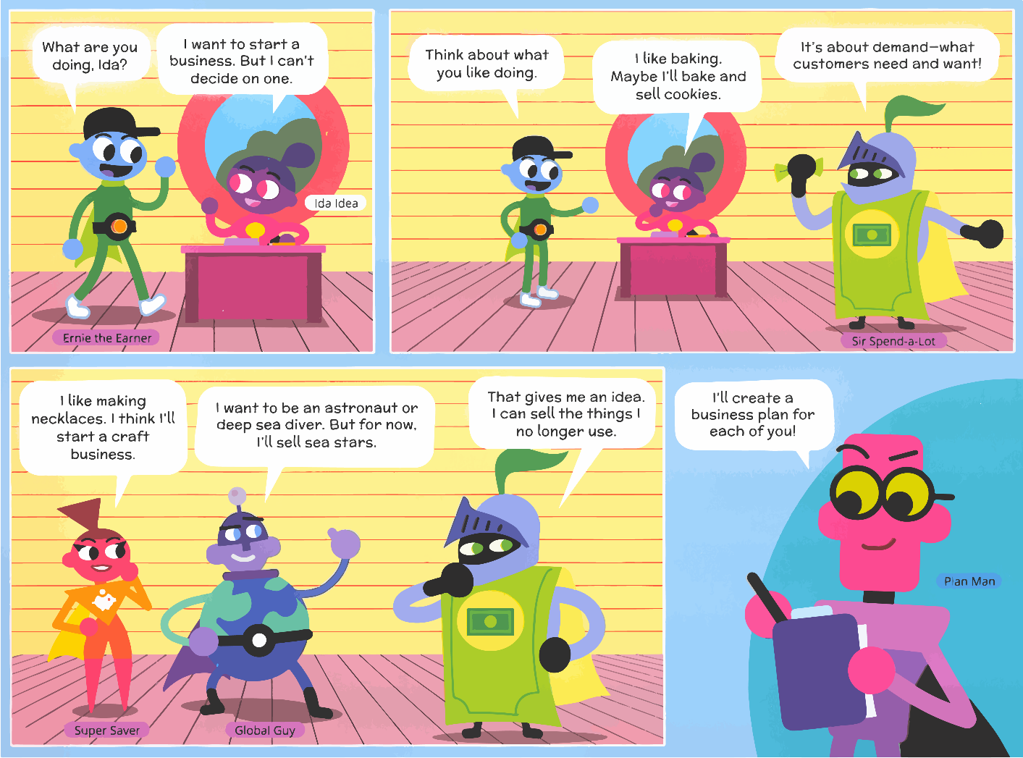
Can skills help a business?
Pg.5

Slide 29

Select a Business Idea
Pg.7
Use your 3-4 interests and write down a business idea you have

Slide 30
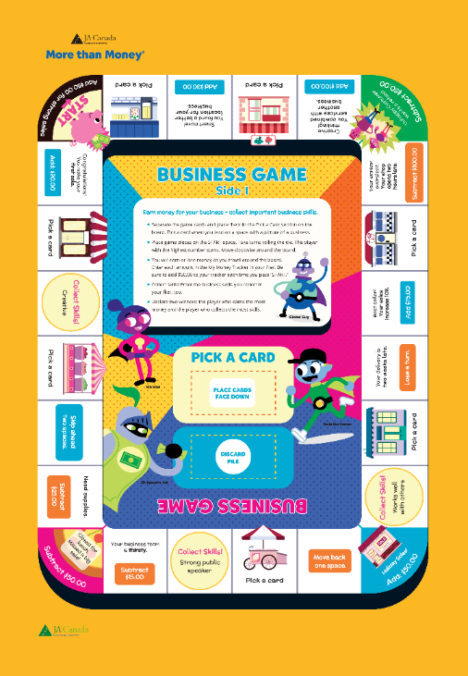

Money Tracker | Business Game | Side 1
1. Place the YELLOW game cards on the Pick a Card section of the board.
2. Place game pieces on START. To begin play, student with the next birthday goes first, clockwise from there.
3. You will earn or lose money as you travel around the board.
4. Enter each amount in the “My Money Tracker” in your workbook. Be sure to collect $50.00 each time you pass START.
5. Collect skills! Enter the business skills you collect in your workbook, too.
6. Two winners will be decided for the game: the student with the most money and the student with the most skills!
Notes:
Depending on Health & Safety Protocols:
The host teacher should determine whether the game can be safely played or move on to the next activity.

Slide 31
Business Game Money Tracker
Pg.6

Slide 32
Summary and Review – Lesson 2
Can you define business, goods and services?
Did you identify businesses to start?
What did you learn about entrepreneurs?

Slide 33
Lesson 3: Build a Business
Lesson 3: Build a Business

Slide 34
Objectives
Identify the steps for building a small business
Develop a business plan

Slide 35
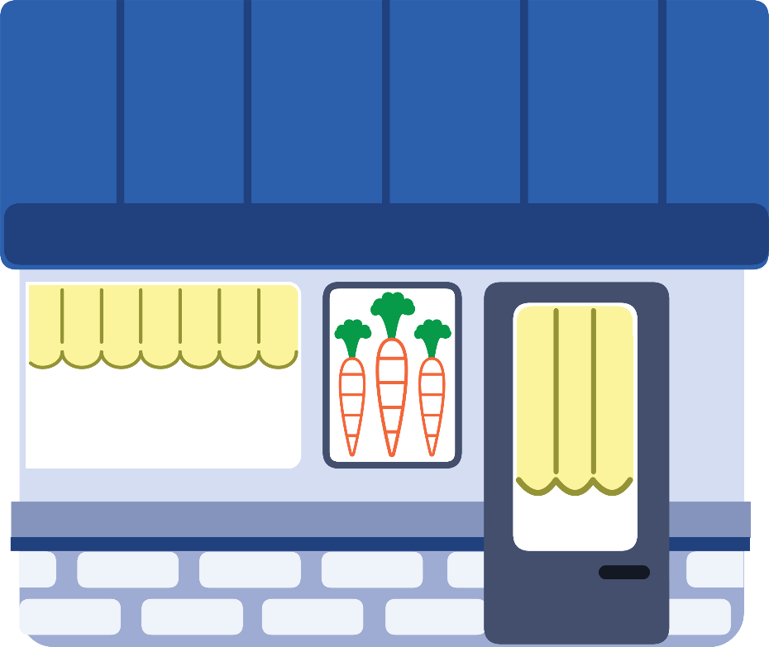
What is a business plan?
Business Plan
Goals a business owner wants to achieve
Steps needed to reach goals

Slide 36
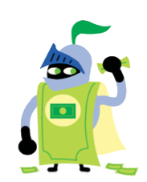
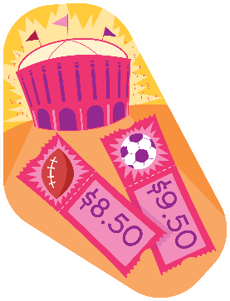



5W’s Business Plan
Who
What
When
Where
Why
Who are your customers?
What products or services will you sell?
When will your product or service be ready?
Where will you get the money to start?
Why is your business needed?

Slide 37
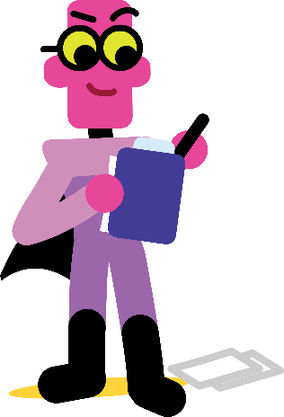

New characters
Plan Man
Show How
Organized
Knows how to run a business
Works with Ida
Knows about advertising
Uses skill to help businesses

Slide 38
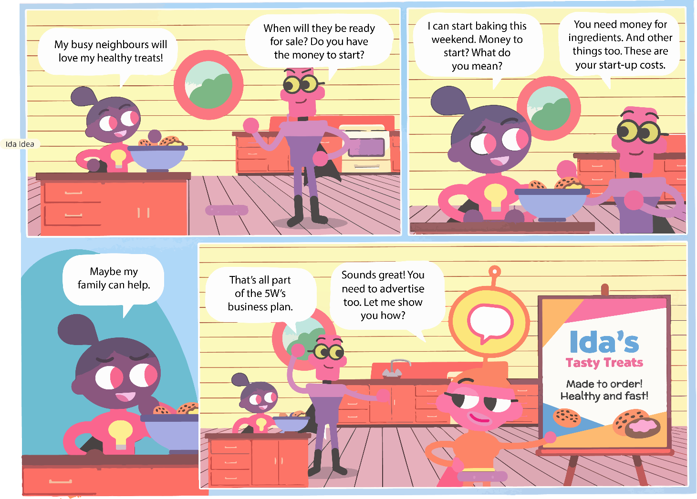
What are the 5W’s of Ida’s business?
Pg.8

Slide 39
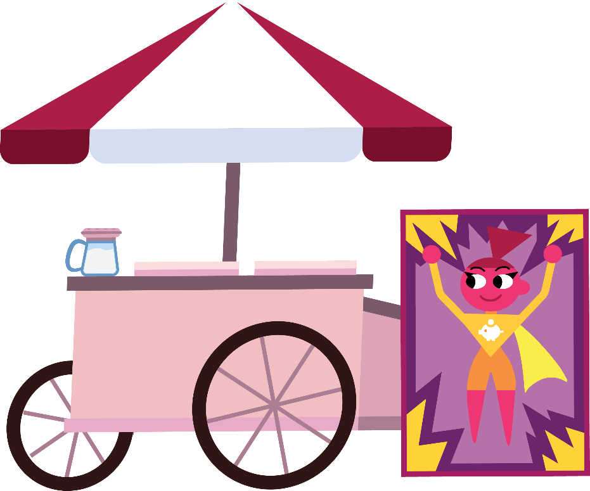
What is advertising?
Advertising
Encouraging people to buy your services or goods

Slide 40
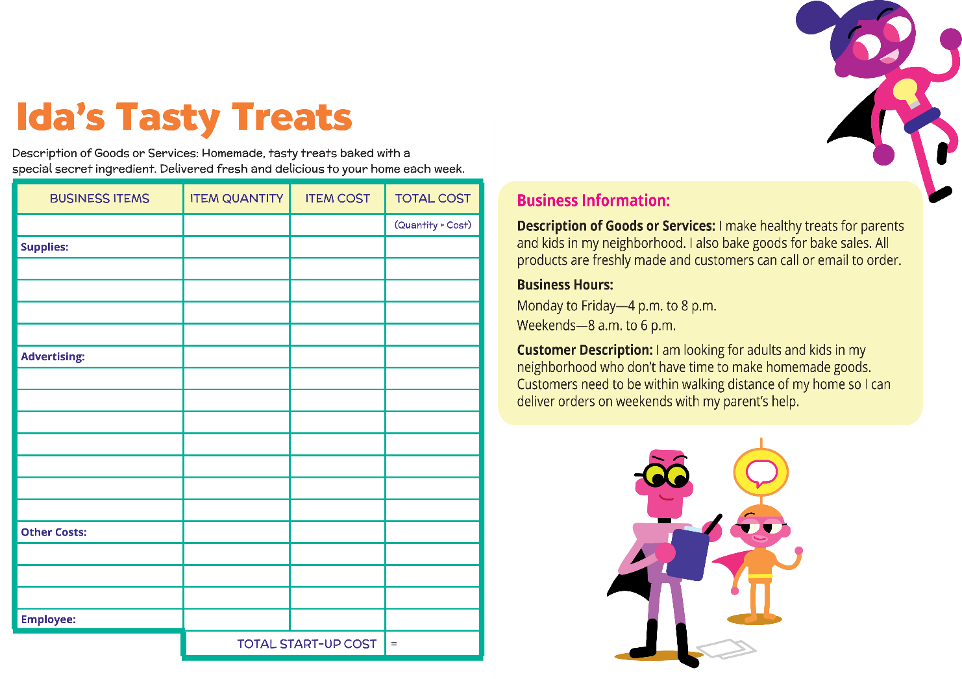
Business Plan for Ida

Slide 41

What are expenses?
Expenses
Spending money on something needed for business

Slide 42
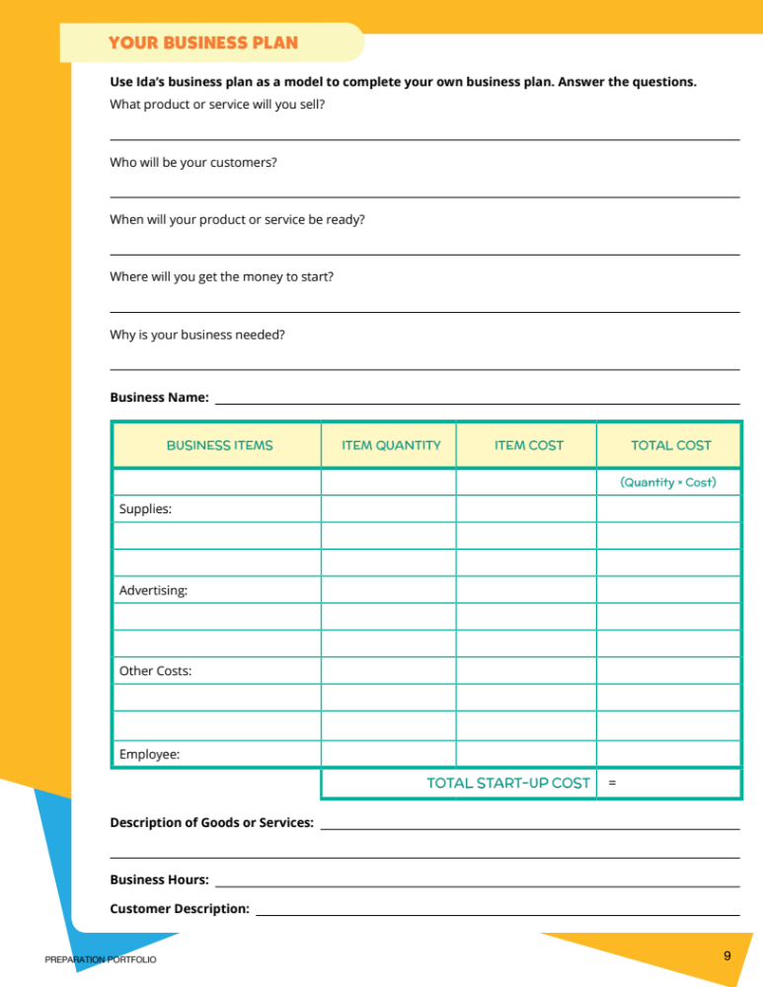
Your Business Plan
Pg.9

Slide 43
Summary and Review – Lesson 3
What are the steps for building a small business?
What was your main takeaway from your business plan?

Slide 44
Lesson 4: Run a Business
Lesson 4: Run a Business

Slide 45
Objectives
Why financial institutions lend money
Trustworthy borrower decisions and traits
Record and track financial gains and losses

Slide 46

Review: Financial Institutions
Financial
Institutions
A business that provides money-related services

Slide 47
Review: Money on the move
Pg.4
Businesses
People
Banks

Slide 48
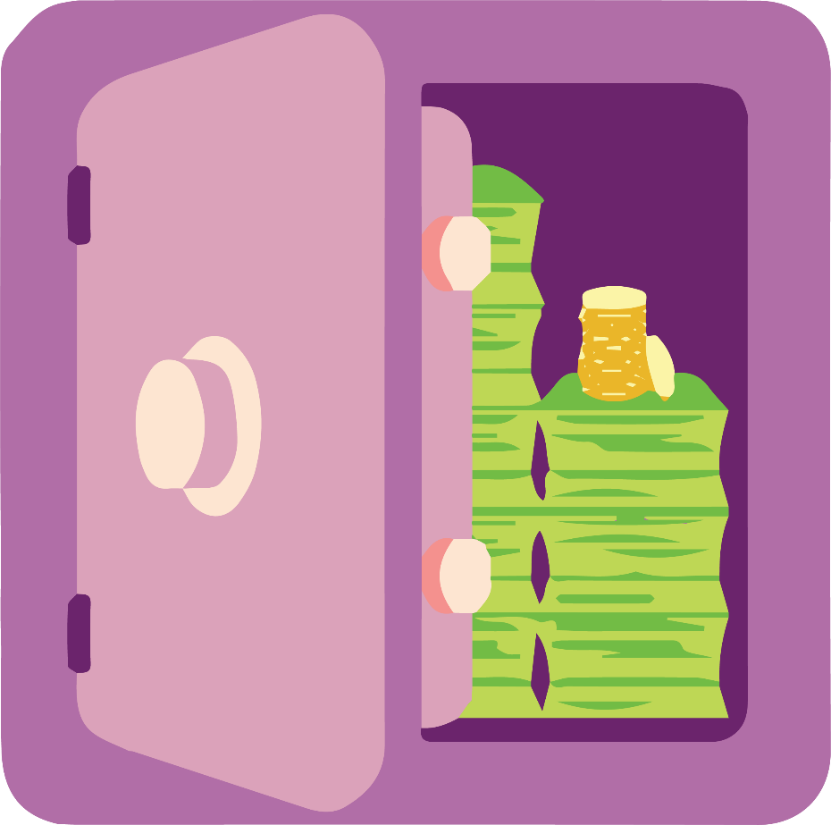
What is a business loan?
Business Loan
Money borrowed to start or run a business

Slide 49
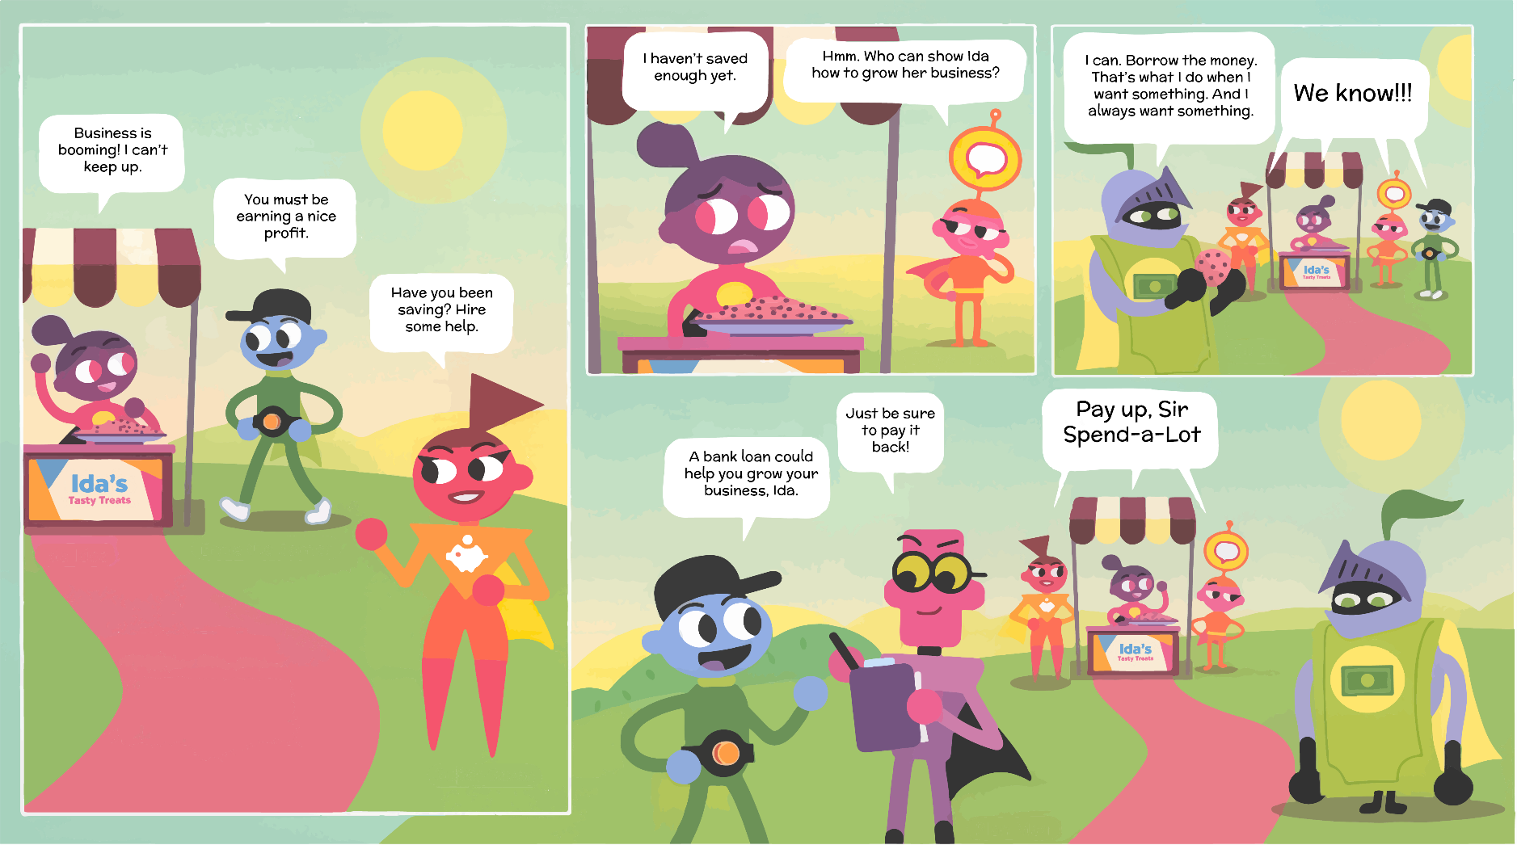
Ida’s Decision Making
Pg.10

Slide 50
Questions
What does Ernie mean when he says that Ida is a good risk?
What do the characters know about lending money to Sir Spend-a-Lot?

Slide 51

What is decision making?
Decision Making
Process of choosing between different options

Slide 52
Simple Decision-making Chart
FOR
AGAINST
List all the good reasons
More reasons here are generally better choice
List all the bad reasons

Slide 53


Traits of a Trustworthy Borrower
Pg.10
Qualities:
Dependable
Honest
Able to Repay
Timely with Payments
Experienced
Write this down on Page 10

Slide 54
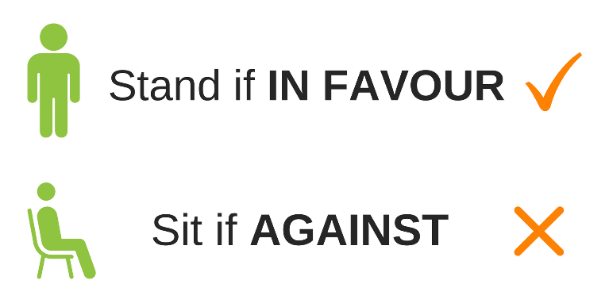
Do you lend this person the money?
1
2
3
Your friend needs $500 for her new business. She promises to pay it back by Friday.
Your neighbour needs $500 for his new business. He promises to pay it back in two weeks.
A person needs $500 for their new business. They have never borrowed money before but have a letter from their boss saying they are always on time and a good worker.
Notes:
Due to Health & Safety Protocols: It is recommended that students stand if they are in favor of giving a loan and stay seated if they are against giving a loan.

Slide 55
Decision Making Examples
4
5
6
A person needs $500 to start a new business. The person was caught stealing a sweater from a store once.
A person needs $500 to start a business. They have no job.
A person needs $500 for business supplies. They promise to pay it back after their vacation in one or two months.
Notes:
Due to Health & Safety Protocols: It is recommended that students stand if they are in favor of giving a loan and stay seated if they are against giving a loan.

Slide 56

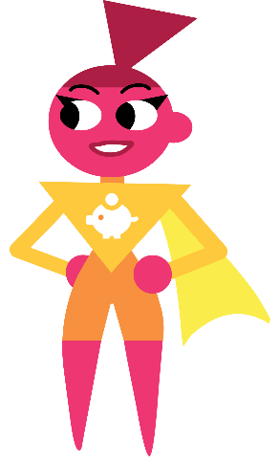
Paying back a loan
Profit
Loss
Interest
Income earned after all expenses are paid
When a business pays more expenses than it earns
Money paid for using someone else’s money

Slide 57
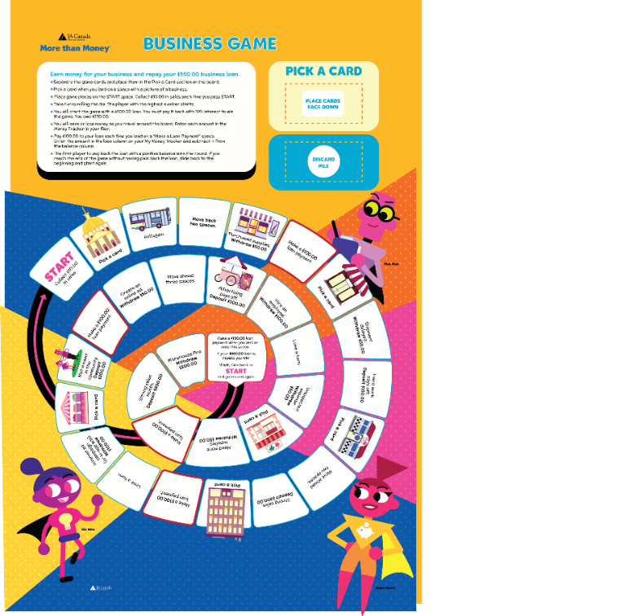
Money Tracker | Business Game | Side 2
Place the BLUE game cards on the “Pick a Card” section-top of the board. Place game pieces on START. To begin play, student with the next birthday goes first, clockwise from there.
Collect $50 each time you pass START.
You will start with a $500 loan. You must pay it back with 10% interest to win the game. You owe $550. You need to subtract money from your balance each time you make a payment.
You will earn or lose money as you travel around the board. Enter amounts in your workbook.
Each time you land on a “Make a Loan Payment” space, enter $100 in your loan payment column and subtract it from the balance column.
The first player to pay back the loan with a positive balance wins the round. If you reach the end of the game without paying back the loan, slide back to the beginning and start again.
Notes:
Depending on Health & Safety Protocols:
The host teacher should determine whether the game can be safely played or to move on to the next activity.

Slide 58
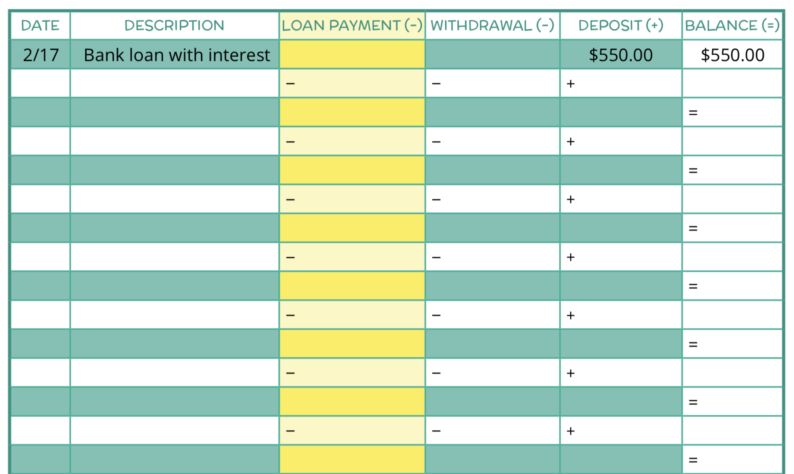
Let’s Start!
Pg.11

Slide 59
Summary and Review – Lesson 4
Why do financial institutions lend money?
What are some trustworthy borrower traits?
How do you record and track financial gains and losses?

Slide 60
Wrap Up
Share your feedback:
What did you like best about More than Money?
What did you learn?

Slide 61

Thank you!

