Slide 1
JA Central Ontario
Company Program
Start Here.
Notes:
Welcome to the Company Program!
NOTE TO ADVISORS:
Before you begin, please keep in mind:
Slides will include notes and speaking points
Agendas will include suggested timings
If you do not have time to cover a section, make sure you adjust and move it to your next meeting
Note the “optional” elements - feel free to skip/move these to later dates
Please note:
Teams have the choice to complete their product selection OR their elections first this year.
It’s up to you and your team to decide which you’d like to complete first as long as both product selection and team elections are completed by Week 4.
We recommend that you do product selections and elections (in whichever order preference) in Weeks 3 (Week of Nov 18-22) and 4 (Week of Nov 25-29).
Attention:
Please do not share the PPT deck with students, parents or anyone outside of your advising team.
If you must share, please PDF a copy before sending.
Students should not have access to this PPT deck or the template for any reasons.
Should you have any questions or concerns, please do not hesitate to reach out to the JA Company Program team!
Email: companyprogram@jacentralontario.org

Slide 2

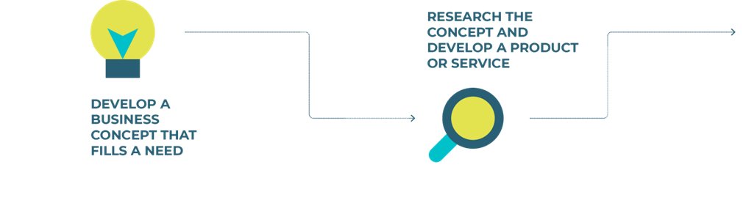
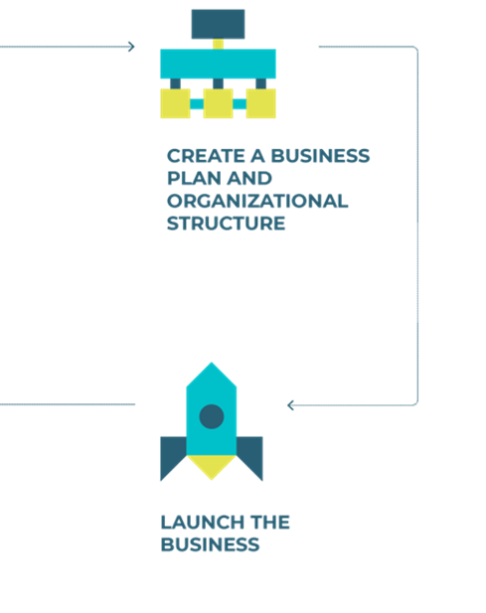
Company Program Cycle
This year, you will be able to choose whether you want to do your elections first or product selection first.
Make sure that both elections and product selections are completed no later than Week 4.
The earlier you have your product and executive team in place, the sooner the team can get their approval from JA and start their business.
Notes:
IMPORTANT FOR 2024/2025:
Product Approval Form & Executive List are both due by Friday, November 29th (end of Week 4)
Please note:
Teams have the choice to complete their product selection OR their elections first this year.
It’s up to you and your team to decide which you’d like to complete first as long as both product selection and team elections are completed by Week 4.
We recommend that you do product selections and elections (in whichever order preference) in Weeks 3 (Week of Nov 18-22) and 4 (Week of Nov 25-29).
Brainstorming/Ideation + (must be completed by week 4):
You must allot time for the team to complete their product pitches AND complete the product approval form before the deadline of Friday, November 29th
Therefore, brainstorming/ideation can take place between weeks 1 to 3 and product pitches and selection should take place sometime between weeks 3 and 4.
If you need more time, you can request an extension to submit the product approval form by a week.
Often teams will have wished they selected their product sooner so that they could get started earlier so it’s not always necessary to take more time.
Executive Elections (must be completed by week 4):
You can opt to do your elections BEFORE or AFTER product selection this year. Elections must be completed by Week 4 (normally they are completed in Week 3 or 4 depending on what week you do your product selection). You must submit your executive list and organizational structure to JA no later than Friday, November 29th.
Student Management Training:
Student Management Training is IN-PERSON this year taking place at the BMO Academy (Yonge & Dundas)
Students elected to the 7 mandatory executive roles must attend this mandatory meeting (they can request for exemption if they have a valid reason and can appoint another student to attend in their place
JA must submit the names of attendees to the venue by Monday, December 2nd so the deadline to submit the executive names (November 29th) is a firm deadline.

Slide 3
PHASE 1
Inspire
Notes:
Phase 1: Participants learn that JA Company Program is a life changing, hands-on experience that aims to inspires them to create an exciting entrepreneurial venture through collaboration.
Objectives:
Get to know each other, including strengths and motivations
Establish expectations and excite students about the program learning opportunity
Collaboratively develop group working norms
Consider a variety of possible products, services, and business models
Learn about the roles available within the Company and identify leadership styles

Slide 4

Week 1 Agenda
Welcome & Attendance
Introductions
Ice-breaker
Admin Details
Brainstorming & Pitching (Bag of Junk) Activity
Product & Service Research Assignment
Executive Roles & Elections
Questions & Wrap-up
Notes:
Overview
The first meeting will set the tone for the rest of the program. Keep the energy high as you get to know the group and ensure that everyone is aware of what lies ahead. Group members will be introduced to the concept of ideation as they begin to brainstorm product and service ideas. This Phase will allow students to get to know each other and establish expectations about the program.
Mentor Preparation
Ensure your location has access to computer/laptop, projector (or screen) and speakers. If this is not available, check with your Program Manager for directions.
Review the instructions and notes in the slides to become familiar with materials/activities.
Review videos and materials in advance on the JA Campus
Prepare your attendance tracking document – we recommend using the Record Keeping Tool
Prepare items needed for Bag of Junk brainstorming activity.
Prepare photocopies of the Product and Service Research Assignment.
Note: All documents and videos referenced in the detailed instructions are available on the JA Canada Campus under Browse --> JA Company Program.
Agenda (with suggested timing)
Welcome & Attendance (5 min)
Introductions (15 min)
Ice-breakers (30 min)
Administration and housekeeping (15 min)
Brainstorming and Pitching (Bag of Junk) Activity (60 min)
Product and Service Research Assignment (15 min)
Executive Roles & Elections (10 min)
Questions and wrap-up (5 min)
Optional Small Group Session (15 min)
Go over the day's agenda with the students. Your welcome and introduction are built into the next slide.

Slide 5

Welcome!
Advising Team Contact Info
UPDATE ADVISORS CONTACT INFORMATION HERE
JA Company Program
Contact Info
companyprogram@jacentralontario.org
Notes:
Welcome
Introduce yourself and the advising team.
Direct students where they can address additional questions and concerns
Use this time to take attendance
Students were asked to complete a goals sheet prior to starting – if they have completed it, you can collect and review as an advising team to help you get to know the students’ individual goals
Attendance
We recommend using the template included in the Record Keeping Tool to keep track of attendance.
The Lead Advisor should have the most updated list of students
Students can request to change programs up until November 15th. Changes are only granted if there is space available in the program they wish to change to.
PLEASE NOTE: Any changes must be approved by JA, and not at the advisor level. Students must complete a form found https://www.jacentralontario.org/company-program/registration/ to make requests.
If you have any students attend your meeting that is not on your student list, please let them know they will need to reach out to JA before attending - NO EXCEPTIONS.

Slide 6

Ice Breaker
Notes:
Conduct an ice-breaker with students (30 minutes)
Feel free to refer to the Team Builders and Ice Breakers document and select an icebreaker from the “Getting to Know Each Other” list.
Things to keep in mind:
You may have a mix of new and returning students to the program. Be sure to try and make everyone feel welcome in the first session.
Some students will sign up to JA Company Program with friends they have made previously. There is a risk that cliques can form at the first meeting. You should do all that you can to bring the group together as a whole.
Facilitate introductions while sitting in a circle. Allow everyone to introduce themselves (name, grade, and school, new or returning to JA). Don’t forget to have all mentors also introduce themselves. If possible, share why you are a volunteer with JA.

Slide 7


Admin & Housekeeping
Review Student Orientation if you did not attend
Remind your parents to complete Parent Consent Form online
Go online and set up an account on the JA Canada Campus: https://www.jacampus.org/
Housekeeping Rules
Contacting Advisors
Other
Notes:
Administration and housekeeping
Students will have attended the Virtual Student Orientation. Direct students to the recording on the Company Program HQ site if they did not attend and have not reviewed it.
Remind students to have their parents complete the online Parent Consent Form - this is mandatory in order to participate in the program. The online form was emailed directly to the parent/guardian on file. If their parent/guardian did not receive it, they can email JA to have it re-sent.
The JA Canada Campus will become important tools for students over the program. Encourage them to go online and create an account. They will be able to access important information and documents about the program.
Review any housekeeping rules for your meetings - this may include important notes regarding your meeting space (rules on bringing food/drinks, where the restrooms are, restricted areas, etc.) and if you’re meeting virtually, how chat and other functions work within the virtual meeting platform you are using, etc.
You will determine as a team your group norms in your next meeting but for now set the rules and expectations for your first meeting to ensure it goes smoothly.
You may also want to establish and clarify contact methods and hours for advisors: let your students know the preferred way for students to communicate with you (i.e. email address, phone number) as well as the best days and times to reach you. You may want to set expectations for students up front as to your response time (i.e. if they email you that evening, they should wait 1 to 2 business days before following up for a response, etc.)

Slide 8

Company Program Resources
All content and materials for students will be found on the JA Campus
To access the portal, go to the website below and create an account
https://www.jacampus.org/
Select “After-School Company Program”
You must enroll to see the resources
Additional resources can be found on the JA Central Ontario Headquarters (HQ):
https://www.jacentralontario.org/company-program/hq/
Notes:
Review where students can locate JA Company Program resources

Slide 9

Company Program Deadlines
All deadlines are due at 11:59 PM on the dates listed on the JA Calendar.
More information about each deadline and how to submit will be shared in the weekly emails.
Notes:
Review major deadlines on the Company Program HQ including the first few:
Product Approval Form Due – Friday, November 29th
Executive List & Organizational Chart – Friday, November 29th

Slide 10
Company Program Events
*in-person* STUDENT MANAGEMENT TRAINING
Saturday, December 7th – Full Day (9 a.m. to 3 p.m. TBC) – More details to come
In-Person Event – Downtown Toronto
Mandatory for all students elected to the 7 mandatory executive roles
Student will learn about departmental and leadership roles and responsibilities
SOCIAL MEDIA CHALLENGE WEEKS
February 3 to 14, 2025
Students will post on social media each day to earn points for the Team Challenge. JA will provide the guidelines each day of what to post.
​
Notes:
Review Company Program Events
This is just a high level review of the events the students will have access to
More information will be shared throughout the year

Slide 11
Company Program Events
*IN-PERSON* TRADE SHOW
March Break – details TBD
In-person event
All Company Program teams will come together to pitch their products to guests and judges.
​*In-Person* INTERVIEW NIGHT
Details TBD
In-person Event
Student award finalists will present to judges as to why they should win in their nominated award category.
​*VIRTUAL* VENTUREON
Details TBD
Virtual Event
End of year celebration to recognize students and teams for their achievements. Award winners are announced at this event.​
Notes:
Review Company Program Events
This is just a high level review of the events the students will have access to
More information will be shared throughout the year

Slide 12

Brainstorming & Pitching
When Brainstorming, be sure to:
Defer judgment of ideas
Go for quantity over quality
Build on the ideas of others
Don’t hold back
Move quickly to the next idea
Record Everything
Notes:
This is now the time for students to start critical brainstorming. The key thing is to ensure everyone defers judgement of ideas while in the initial process.
Emphasis that constructive criticism should be respectful and positive, and that it can lead to better ideas overall.
There are many approaches that this process can take. You may want to focus on ideas to solve a customer need that is of particular interest to the group, or products and services that would apply to an appealing business model. Or perhaps this is simply a “free for all” to discover what the group with gravitate toward.

Slide 13

Brainstorming & Pitching
Brainstorming Video: https://youtu.be/RgPIkx2JyQU
Notes:
Review the Brainstorming Video

Slide 14

Brainstorming & Pitching
“The best ideas for companies often stem from attempting to solve personal problems or irritations. If we tried to think of a good idea, we wouldn’t have been able to think of any ideas at all.”
-Brian Chesky, Founder AirBnB

Slide 15
Brainstorming & Pitching
“The Itch” Video:
https://youtu.be/B5VjFIR8qcc
“Where Good Ideas Come From” Video:
https://youtu.be/NugRZGDbPFU
Notes:
View both videos if time allows

Slide 16



Brainstorming & Pitching
Brainstorming can be done individually, in pairs and in groups
Brainstorming Individually
Working individually, record as many ideas as possible
Brainstorming In Pairs
Working with a partner, share ideas by taking turns. One person shares while the other person records.
Brainstorming In Groups
Everyone shares their ideas in a lively, fast-paced group discussion. Remember not to judge ideas.
Notes:
Guide students through the different ways brainstorming can be done.

Slide 17
Overcoming Challenges
Ideas don’t seem big enough. Don’t limit yourself to what is real and possible. Small ideas don’t often have the ability to become big ideas without considering the seemingly impossible.
Snickering at ideas. There are no bad ideas. Introduce the phrase “Yes, and….” to encourage students to build on ideas that have been presented before.
You get stuck. Prompts often help to create breakthroughs. Consider asking the following prompting questions:
What if you were in space?
What if money was no object?
How would you deal with this if you were in a different time period?
What would you do if you were someone else?
How would you think about the problem if you were a different gender?
How would you think about the problem if you were 10 years younger?

Slide 18

Brainstorming & Pitching
Think about filling a customer need. Identify a customer need that could use a solution.
Attempt to answer the question “How might we solve this need?”
Notes:
Allow students time to think and share their ideas while utilizing tips for brainstorming.

Slide 19
Brainstorming & Pitching
Let’s Brainstorm
Notes:
Allow students time to think about the scenario on the previous slide.
Invite students to share their ideas through brainstorming.

Slide 20

Brainstorming & Pitching
Bag of Junk
Notes:
Once students understand the idea of critical brainstorming, follow the instructions for the Critical Brainstorming, Bag of Junk and Pitching Activity: https://lms.jacampus.org/mod/resource/view.php?id=6217

Slide 21
Bag of Junk
Work individually or in groups of 2-3
Using the items you have chosen, create a potential new product or service – think about a daily problem you run into personally or a bigger world issue as inspiration for your product or service
Not all items have to be used or utilized for their intended use
You have 15 minutes of planning and creating and preparing your pitch
Notes:
Advisor Preparation: Gather various random objects from around your home or office (i.e. spoons, screws, bar of soap, paper clips, foam cups, etc.)
Make 3-5 bags out of these random objects Instructions:
• Divide the group into teams consisting of three to six members.
The teams should determine how they will work together and make decisions.
• Provide each team with a bag filled with assorted objects. These can be almost anything, i.e. a wooden spoon, a screw, a bar of soap, a computer disk, etc.
Explain that the objective of the game is to create a potential new product or service using only the items in the bag.
Encourage teams to think about a daily problem they run into personally or a bigger world issue as inspiration for their new product or service.
• Not all items must be used nor do they have to be utilized in their intended use.
• Inform students they will have 15 minutes for planning and creating.
• Once students have created their product or service, they must prepare a formal pitch.
***For virtual programs, ask students to choose a random objects from home. Pair students up in groups and they must come up with a product to pitch from those objects.***
****This is just an exercise in pitching, NOT their actual product pitch****

Slide 22
Bag of Junk
Your pitch should be max 1 minute and include:
A clearly stated problem
Description of the product/service solution
Who is the audience and/or customer (target audience)
What benefits will they enjoy
What will it cost
Why would a customer choose this product over another (competitive advantage)?
Catchy tag line to attract the attention the product deserves
Notes:
Each team will create a 1-minute pitch to be done in front of the group.
Pitches must include:
A clearly stated problem.
A description of the product or service solution.
Who is the audience and/or customer? (target audience)
What benefits will they enjoy? What will it cost?
Why would a customer choose their product over another (competitive advantage)
What catchy tag line will attract the attention the product deserves? G
Give each group the opportunity to prepare and practice their pitch before presenting it.
Mentors can provide feedback on product or service ideas as well as pitches.

Slide 23
Bag of Junk
Debrief
1. How easy or difficult was it to identify a problem? How easy or difficult was it to create a solution with your bag of junk items? ​
2. How did the dynamics of your team help you be more innovative and creative? ​
3. How could the team improve the decision-making process? ​
4. Which presentation was most effective? Why?
Notes:
Debrief Questions
1. How easy or difficult was it to identify a problem? How easy or difficult was it to create a solution with your bag of junk items?
2. How did the dynamics of your team help you be more innovative and creative?
3. How could the team improve the decision-making process?
4. Which presentation was most effective? Why?
Students can consider the following points when making their product selection for their JA Company.
It is important that everyone stands behind their product or service since each member of the company will be responsible for promoting it and selling it.
Some students start JA Company Program with ideas for the businesses they want to create. Make sure students understand that a company must agree on a product or service, and some ideas will not be chosen. This doesn’t mean they are bad ideas; they may simply have to wait for another time. Finding the right business idea is really important to the success of the student company.
It is important to think carefully about their market, consider the steps needed to produce a product and research where they will get the source materials for production.
Let participants know that in a few weeks, they will get to pitch their idea to the group. This was their first practice at pitching.

Slide 24
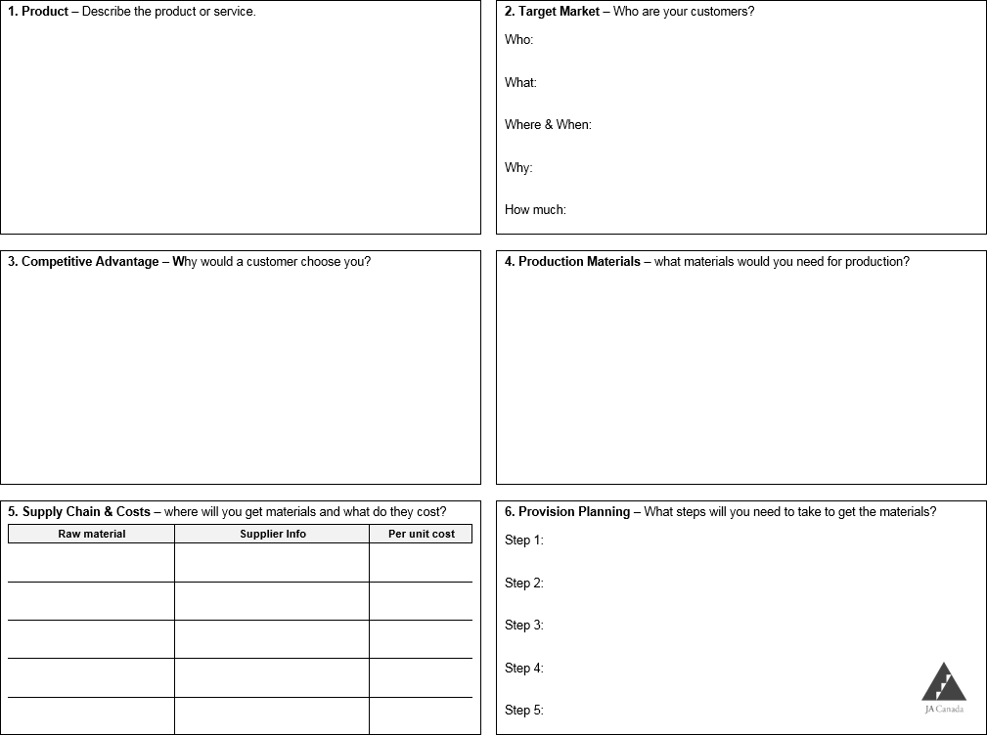
Product & Research Assignment
Answer as many of the questions that follow on the provided answer sheet.
This will help you prepare for pitching your idea to your team.
Notes:
Let students know that they can continue to brainstorm ideas at home and more time will be allotted to this next week.
Review the Product or Service Research Assignment document with the group.
The Product or Service Research Worksheet will help them work through the viability of some of their ideas. They should spend time completing for their product ideas. Pitches will occur in Weeks 3 to 4 (depends on the team). Students should select only one idea to explore in detail. They may choose to work individually or in groups. However, each student is encouraged to research one idea.
Be sure to establish the expectation that the Product or Service Research Worksheet must be completed if a student wants to be eligible to pitch their idea. This worksheet is designed to be a simple way to structure a “Pitch Deck” (slideshow) if students choose to prepare visuals for their pitch.
Students can access the Product and Service Research Worksheet through the Campus.

Slide 25
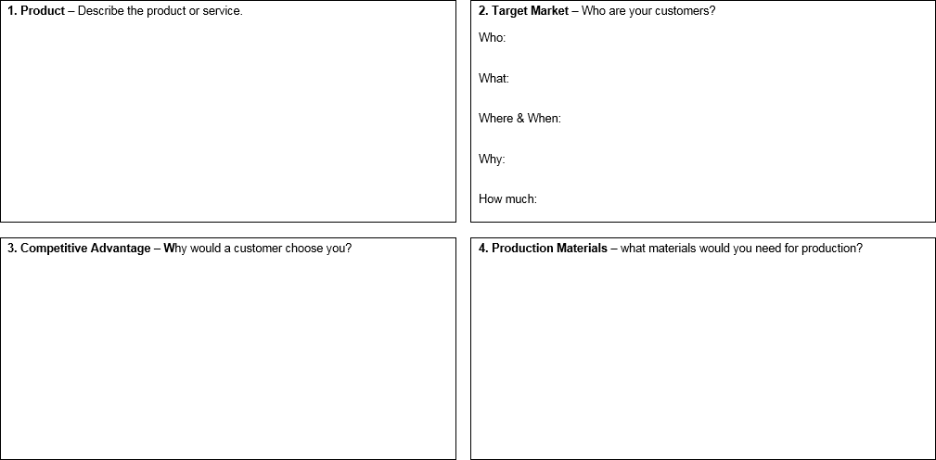
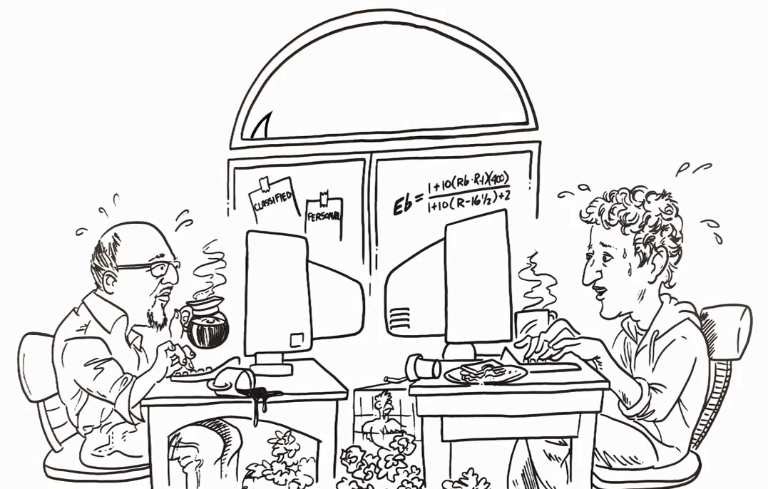

The Product
Describe the product or service.
Be as detailed as possible including any packaging that will be required.
Notes:
Breaking down each element in the Product or Service Research Worksheet - Student should be using this as a guide to complete the research for their product ideas/pitches

Slide 26

Target Market
Your target market is your defined group of customers who are most likely to purchase a product or service.
Who? Who are your customers, what is their age range, what gender are they?
What? What would they think of your product or service?
Where & When? Where would they do business with you? When is the best time for you to sell to them?
Why? Why would customers want to use your product/service?
How much? What price would they be willing to pay?
Notes:
Breaking down each element in the Product or Service Research Worksheet - Student should be using this as a guide to complete the research for their product ideas/pitches

Slide 27


Competitive Advantage
What will lead a customer to buy your product or use your service over another?
What other products or services would be in direct competition and how much they charge?
What business model best suits your ideas or creates an advantage?
Production Materials
Describe the materials/resources need for the product or to provide your service. Include everything you may need to implement your product or service. For example, if you are creating a website, you may need a domain, website builder, design software, stock photography, etc.
Notes:
Breaking down each element in the Product or Service Research Worksheet - Student should be using this as a guide to complete the research for their product ideas/pitches

Slide 28
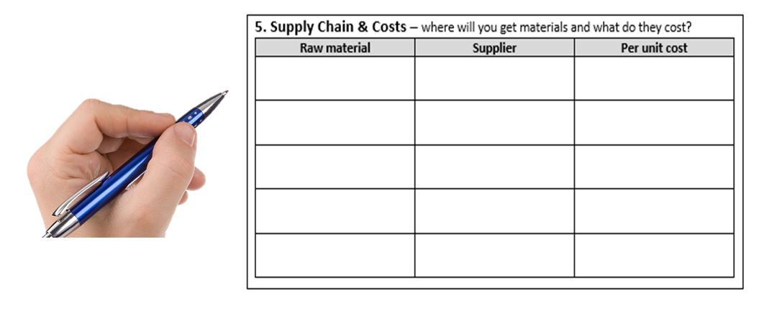
Supply Chain & Costs
Go online to find out the cost of the materials you will need to produce/implement your product or deliver your service or dropship your product.
Shop around!
How much do you think you could sell your product or service for?
Notes:
Breaking down each element in the Product or Service Research Worksheet - Student should be using this as a guide to complete the research for their product ideas/pitches

Slide 29

Provision Planning
Are materials/resources easily available?
Are there enough steps in production/implementation to involve the whole team?
Are special skills required? Does your team have those skills?
Are there licenses or certificates needs to provide this product?
Are there any issues with availability of materials/resources for this product or service?
Notes:
Breaking down each element in the Product or Service Research Worksheet - Student should be using this as a guide to complete the research for their product ideas/pitches

Slide 30


Get Ready To Pitch
Prepare your Pitch!
In 2 or 3 weeks, students will be pitching their product ideas to be considered by their team.
You will have maximum of two minutes to pitch your product or service idea.
Your Product or Service Research worksheet should be used to create a six slide "Pitch Deck".
You must hand in the worksheet or a printed "Pitch Deck" to be eligible to share your idea.
Be creative! Have a prototype if possible.
Your peers will be evaluating pitches. Mentors will tally up scores to determine the top product or service.
Notes:
Many students will be eager to understand how their product idea will be considered and selected. This is a good time to review the Product and Service Guidelines
Be sure to establish the expectation that the Product or Service Research Worksheet must be completed if a student wants to be eligible to pitch their idea. \
Remind students of the importance of ethics when researching suppliers. Also, if the product can have a positive impact through using recycled goods that would be of value to the JA Company.
This worksheet is designed to be a simple way to structure a “Pitch Deck” (slideshow) if students choose to prepare visuals for their pitch.

Slide 31
Get Ready To Pitch
Great Pitches Include:
A clear description of the product or service
Target market and competitive advantage
Approximate production or set-up costs
Suggested selling price and estimated break-even number
Fun tag line to promote the product or service

Slide 32

Product and Service Guidelines
The product or service should:
Fill a need (or at least a perceived need),
Be something customers are willing to pay for,
Be something that Company members are passionate about.

Slide 33


Product and Service Guidelines
The product or service should:
Fill a need (or at least a perceived need),
Be something customers are willing to pay for,
Be something that Company members are passionate about.
Be able to make revenue
Notes:
Tip – Students can look into the UN Sustainable Development Goals if they are stuck finding a direction to brainstorm needs to fill

Slide 34
Example of Restrictions
Food and cosmetic items of any kind
Events are not allowed
Products should not misrepresent JA values/beliefs in any way
Products and Services must be in good taste and cannot be offensive to the general public including , but not limited to, racial, gender, sexual or religious sensitivities.
​For list of restriction and full product and service guidelines, review the document "Product and Service Guidelines"

Slide 35






Company Program Cycle: ELECT
Elections
Each team will elect an executive team consisting of the positions on the next slide.
To be elected, students must submit an application form and will need to prepare a presentation stating why they should be elected into their chosen role and the team votes on each position.
Student Management Training
December 7, 2024
In-Person Training
Mandatory for the 7 mandatory executive roles
Brainstorm
a product
Elect
An executive
team
Buy shares
in your company
Liquidate
your business and keep the profits
Market & sell
your product for real money
Produce & Implement
your digital idea
Notes:
Let students know when the elections will take place – your team can decide but must be completed by week 4
Review the elections process JA has outlined so that students can review and consider if they wish to nominate themselves or not.
JA Process requires them to complete an application form and submit it to you by Week 2 + a 1-2 minute pitch on election day. You may choose to add any additional requirements (individual interviews, extra application steps, etc.)
Inform students that those elected will be required to attend virtual Student Management Training on December 7th.

Slide 36
Company Program Cycle: ELECT
Mandatory Elected Company Program Roles
President
VP of HR
VP of Finance
VP of Sales
VP of Marketing
VP of Production
VP of Technology
Non-executive Roles
If a student doesn't wish to run for an elected position, they will decide on a job title and which department they want to work in after elections occur. Every student has an important role in the company regardless of what department they are in.
Brainstorm
a product
Elect
An executive
team
Buy shares
in your company
Liquidate
your business and keep the profits
Market & sell
your product for real money
Produce & Implement
your digital idea
Notes:
Briefly review the elected Company Program roles and direct students to review the executive role descriptions to see if they are interested in running. Executive Team Role Descriptions
It is up to the team to choose how many roles are actually needed for their company (dependent on size, interest, etc.).
Mandatory roles (these students are invited to student management training)
● President
● VP Finance
● VP Marketing
● VP Sales
● VP HR
● VP Production
● VP Technology
Optional roles (these students are not invited to student management training):
● VP Corporate Social Responsibility (can be incorporated into HR instead)
● VP Health and Safety
● VP Environment
Co-executives are NOT allowed – no co-presidents, co-vps.
If a student does not wish to run for an executive role or is not elected into an executive role, they will still play an integral role in their company. Each member will select a department to work in and there will also other titles and roles that the students can decide on to complete their organizational structure.
This year we will also have students work together to name a “second-in-command” for each mandatory role

Slide 37
Questions & Next Steps
Begin the Product or Service Research Assignment
Complete the What’s Your Leadership Style? quiz online and be prepared to share the result at the next meeting.
Submit their Executive Application Form if they wish to apply for an executive role
Notes:
Create an opening for students to ask any questions about the meeting prior to wrapping up.
If you identify any returning students, please have them speak briefly about why they are doing the program again and its impact on their life. This should help with getting students to return the second week.
Remind students to remind their parent/guardians about their parent consent forms prior to the next meeting.
Let students know that next week you will continue brainstorming and research. They will also have the opportunity to nominate themselves for the executive roles.
Direct students to the JA Canada Campus, so they can complete a 2-minute Assessment: What’s Your Leadership Style? in advance of next session.
Encourage students to access the JA Canada Campus to review some of what was covered in this meeting.
Remind participants that entrepreneurs can start businesses on their own or as part of a small group by combining individual strengths and sharing responsibilities. Today is the start of something great!
Optional Small Group Session (15 min)
If timing allows, you can break into smaller groups following your full group meeting. In these early small group sessions, you may want to divide up your advisors and students and rotate each week so that you get a chance to get to know everyone.
This first session can be used to get to know each other more - ask students about their interests, review their personal goals (from the goals sheet) in joining the program and answer any questions.
Reminder that 1:1 is not allowed so these small groups must have at least 1 student and at least 1 advisor.
Mentors:
Gather goals sheets and attendance records
Take a few moments to debrief about the first session with the team of Mentors
If you were not able to cover any material, make a note and move it to your next meeting
Address any questions, concerns or feedback to your Program Manager
Congratulations on completing your first meeting!

Slide 38
Week 2 Agenda
Attendance
Ice-breaker
Defining Group Norms
Corporate Social Responsibility
Leadership Style & Roles
Importance of Prototyping
Brainstorming Continued
Questions & Wrap-up
SMART Goals
Notes:
Overview
During the second meeting, keep students engaged as they continue to examine attributes of a good product or service and prepare pitches. Students will build their team norms, examine the concept of Corporate Social Responsibility, understand the significance of the Company Code of Ethics to help in decision making, and learn about the roles available to them within the Management team.
Mentor Preparation
Review instructions and slides to become familiar with materials and activities
Review videos and materials in advance on the JA Canada Campus
Prepare for Group Norms/Team Canvas using a whiteboard tool or shared doc (i.e. Google doc or Word doc) or print outs
Note : All documents and videos referenced in the detailed instructions are available on the JA Canada Digital Campus.
Agenda
Attendance (5 min)
Ice-Breaker (15 min)
Defining Group Norms (30 min)
Corporate Social Responsibility (15 minutes) – OPTIONAL and can be moved to a later date
Leadership style and roles (10 minutes)
Professional Social Media Profile (15 minutes) – OPTIONAL and can be moved to a later date
Importance of Prototyping (10 minutes)
Brainstorming Continued (10 minutes)
SMART Goals (15 minutes)
Questions and Wrap-up (5 min)

Slide 39
Ice Breaker
Notes:
Refer to the Team Builders and Ice Breakers document and select an icebreaker from the “Getting to Know Each Other”
Don’t skip on the ice breakers! This helps get the students (and advisors) more comfortable with each other and get to know one another.
You may have new students join your second meeting who were not at the first meeting. Give students a chance to introduce themselves.

Slide 40
What is Norming?
A norm is an informal guideline about what is considered normal social behavior in a particular group. For example, in my workplace, people stop for lunch any time between about 11 and 2.
Every team goes through the same 5 stages.
Forming – voting on executives, initial separation into departments, ideas for products
Storming – group conflict, determining how to work together
Norming- group guidelines created, work towards common goals, tasks assigned
Performing – stage of teamwork and focus on task performance
Adjourning – task completion, goals accomplished
Notes:
Whether you are a member of a sports team, group preparing a classroom project, or an employee on a team in the workplace, every team goes through the same 5 stages.
Explain to the members of the Company, that forming, storming, norming, performing and adjourning are the nature of any team journey.
A norm is an informal guideline about what is considered normal social behavior in a particular group.
Provide an example from your work environment that shows how a norm works. If you can’t think of an example, use this one:
“In my workplace, people stop for lunch any time between about 11 and 2. But, if we were working in another place, we would be very surprised to discover that everyone stops precisely on the dot of 12 noon for lunch, whether they are ready to eat lunch or not.”
Optional Notes for each stage is found below should you need it.
Our recommendation is to skip this and go either:
Review “Whose Norm Are These?” & Team Norms Activity
Go directly to the Team Norms Activity
Forming:
This stage involves the first entry of individual members into JA Company Program.
As individuals join the group, they internally asked themselves several questions, such as:
1. What can or does this team offer me?
2. What will I be asked to contribute?
3. Can my needs be met?
In the forming stage, people begin to identify with other members and may also align with members who seem "powerful" or influential.
Storming Stage:
Ideas start to get assessed. This can involve a lot of high emotions
Tensions often emerge among members over tasks and interpersonal concerns.
Coalitions or cliques may form around personalities, views or interests.
This is very important as changes occur during the Storming Stage and the focus begins to shift from obstacles to task accomplishments.
A Code of Ethics and Team Norms can be created to help transition to the Norming Stage.
Norming:
Cooperation becomes more important in this stage
At this point, members of the team begin to become coordinated as a working unit and tend to operate as per a company Code of Ethics and Team Norms that are agreed upon.
Harmony is emphasized in an effort to attain success.
Members are likely to develop initial feelings of closeness, a division of labour, and a sense of shared expectations.
Introduction of using the TEST OF DISCLOSURE as a quick and easy check sometimes can help with decision making (would everyone – employees, executives, shareholders etc. Be okay with the decision we are about to make?)
Once the team gets to the norming stage the team will have worked its way to collective expectations that members will share.
Performing:
Show time!
This is a stage of total integration in which team members are able to deal in creative ways with both complex tasks and interpersonal conflicts.
The team operates in a clear and stable structure, and members are motivated by team goals.
This stage involves the need to refine the operations to meet objects ie. How can we make the product more efficiently?
Adjourning:
In this final stage, team members prepare to achieve closure and disband from each other.
Ideally, teams disband with a sense that important goals have been accomplished.
Members are acknowledged for their contributions and the group's overall success.
The team prepares for the final JA presentation and completes all liquidation activities.

Slide 41

Whose Norm are These?
Match the following brands with their stated norms
Notes:
OPTIONAL
Since operating a company requires a lot of teamwork, it is important to establish team norms. Look over the Whose Norms are These? On the next slides to provide sample norms from large companies. These may serve as examples as they create their own team norms.

Slide 42





Notes:
OPTIONAL
Introduce the companies associated with the logo and have students guess the norms for each.

Slide 43
Think Outside The Box
Lead by example
Learn from experience
Think outside the box.
Help better the brand from the inside out.
The time you spend in the office is up to you, depending on your role, needs and results. That means you can unleash your potential at work knowing your personal life is in great shape too.
Notes:
OPTIONAL

Slide 44
Productivity Is Key
Get stuff done: All engineers should have written code that goes live within a week of starting work.
Use whatever tools you like best, you'll be more productive.
There are no stupid questions. Ask anything you don’t know.
Notes:
OPTIONAL

Slide 45
Fast Is Better
It’s best to do one thing really, really, well.
Fast is better than slow.
There's always more information out there.
You can be serious without a suit.
Great just isn't good enough.
Notes:
OPTIONAL

Slide 46

Boundless Potential
We believe in the boundless potential of young people and are committed to the principles of market-based economics and entrepreneurship.
We possess a passion for what we do.
We believe in the power of partnership and collaboration.
We aim to produce an educational and motivational impact with relevant, hands-on learning experiences.
Notes:
OPTIONAL

Slide 47
Whose Norm are These
Answers
Think Outside The Box
Boundless Potential
Productivity Is Key
Fast is Better
Notes:
OPTIONAL

Slide 48
Building your Team Norms
Code of Ethics and Building Your Team Norms Activity
Notes:
Complete your team norms – this is required and will be useful for your team!
Facilitate the Team Norms Activity then complete the Building Your Team Norms discussion
At the end of the discussion, students should select a small list of the best norms that the entire group seems willing to support. Explain that all norms evolve a little over time; however, it is better to begin with some commonly held understandings about how the group will interact together. If you are conducting your meetings online, encourage students to think about the norms they can set for an online meeting.
Record the shared norms for everyone to review and endorse.

Slide 49


Unanimous, Consensus, Stalemate
Unanimous: Everyone is in complete agreement.
Consensus: May not be the first preference of individuals in a group but it is a decision to which everyone can give their consent. Good consensus process relies heavily on problem-solving, questioning, empathy, and self-sacrifice.
Stalemate: An even draw in terms of those in favour and those opposed. Further discussion is required to move forward.
Notes:
OPTIONAL
This is a good opportunity to introduce the terms unanimous, consensus and stalemate
a. Unanimous: Everyone is in complete agreement.
b. Consensus: May not be the first preference of individuals in a group but it is a decision to which everyone can give their consent. Good consensus process relies heavily on problem-solving, questioning, empathy, and self-sacrifice.
c. Stalemate: An even draw in terms of those in favour and those opposed. Further discussion is required to move forward.

Slide 50
Corporate Social Responsibility
What is Corporate Social Responsibility?
A Voluntary approach that a business takes to meet or exceed stakeholder expectations
Doing well by
Doing Good
Social
Environmental
Ethical
NEW SCHOOL
Profit
OLD SCHOOL
Legal
Revenue
Notes:
OPTIONAL – can be moved to a later meeting if the team wants to spend more time on brainstorming!
CSR (30 Minutes)
Corporate Social Responsibility (CSR) is a voluntary approach that business takes to meet or exceed shareholder expectations. It considers economic, social, environmental, and smart growth and mobility implications in the decision-making process. It is a departure from making business decisions based solely on the financial bottom-line.

Slide 51

Corporate Social Responsibility
What are the Trends?
Modern corporations have developed new trends:
To deliver the good, and not just the goods
To pursue values, not just value
To help make the world a better place
What does this mean?
'Good deeds' are built into business plans
Corporations give back to the community (not just shareholders)
Notes:
OPTIONAL – can be moved to a later meeting if the team wants to spend more time on brainstorming!

Slide 52
Corporate Social Responsibility
Triple Bottom Line
Companies are setting standards where the bottom line is about more than just money
Financial
Performance
Environmental
Sustainability
Social
Responsibility
Be profitable -legally
Reduce, reuse, recycle
Community Participant
Notes:
OPTIONAL – can be moved to a later meeting if the team wants to spend more time on brainstorming!

Slide 53
Corporate Social Responsibility
Why Bother?
CSR can help your company
Customers like it – sales and loyalty increase
Employees like it – more engaged
CSR helps
The environment
The community
Saves money
Notes:
OPTIONAL – can be moved to a later meeting if the team wants to spend more time on brainstorming!
Even though it is early in the process, it is important for students to begin to think about if their company with have a CSR component. Ask the students:
a. How can your JA Company engage in CSR?
b. How are the three P’s going to impact your business? (Profit – financial performance), Planet-environmental sustainability), People-social responsibility)
c. How is the Code of Ethics going to impact your business?

Slide 54

Corporate Social Responsibility
Examples
Tim Horton's
Involved in fair trade
Sponsors sports and other community initiatives
Notes:
OPTIONAL – can be moved to a later meeting if the team wants to spend more time on brainstorming!

Slide 55

Corporate Social Responsibility
Examples
TOMS Shoes
One for One
With every product purchased, the customer is helping one person in need
Notes:
OPTIONAL – can be moved to a later meeting if the team wants to spend more time on brainstorming!

Slide 56

Corporate Social Responsibility
Examples
TenTree
Partnered with non-profits to provide a long-term solution by restoring the ecosystem and offering long-term employment to local communities
Notes:
OPTIONAL – can be moved to a later meeting if the team wants to spend more time on brainstorming!
Can the students think of other examples?

Slide 57
Styles of Leadership
    First Follower: https://www.youtube.com/watch?v=fW8amMCVAJQ
    Steve Jobs - Tips for Management: https://www.youtube.com/watch?v=f60dheI4ARg
    The Science of Happiness: https://www.youtube.com/watch?v=IkMHZ7mchVo
Notes:
OPTIONAL VIDEOS:
Explain that everyone will have a role within the company and be an important member of the team. Some students may choose to nominate themselves for a management role and choose to take on a leadership role.
Present one or two of the suggested videos to start a discussion on the different styles of leadership:

Slide 58
Company Program Cycle: ELECT
Elections
Each team will elect an executive team consisting of the positions on the next slide.
To be elected, students must submit an application form and will need to prepare a presentation stating why they should be elected into their chosen role and the team votes on each position.
Student Management Training
December 9, 2023
Virtual Training
Open to all students but mandatory for executives
Brainstorm
a product
Elect
An executive
team
Buy shares
in your company
Liquidate
your business and keep the profits
Market & sell
your product for real money
Produce & Implement
your digital idea
Notes:
Let students know when the elections will take place – your team can decide but must be completed by week 4
Review the elections process JA has outlined so that students can review and consider if they wish to nominate themselves or not.
JA Process requires them to complete an application form and submit it to you by Week 2 + a 1-2 minute pitch on election day. You may choose to add any additional requirements (individual interviews, extra application steps, etc.)
Inform students that those elected will be required to attend Student Management Training on December 7th.
**the students should have submitted their applications forms to you to review by this week. If you have new students or a lower rate of submissions, you can choose to extend this deadline if needed (and depending when you’ve scheduled your elections.)***

Slide 59
Company Program Cycle: ELECT
Elected Company Program Roles
President
VP of HR
VP of Finance
VP of Sales
VP of Marketing
VP of Production
VP of Technology
Non-executive Roles
If a student doesn't wish to run for an elected position, they will decide on a job title and which department they want to work in after elections occur. Every student has an important role in the company regardless of what department they are in.
Brainstorm
a product
Elect
An executive
team
Buy shares
in your company
Liquidate
your business and keep the profits
Market & sell
your product for real money
Produce & Implement
your digital idea
Notes:
Briefly review the elected Company Program roles and direct students to review the executive role descriptions to see if they are interested in running. Executive Team Role Descriptions
It is up to the team to choose how many roles are actually needed for their company (dependent on size, interest, etc.).
Mandatory roles (these students are invited to student management training)
● President
● VP Finance
● VP Marketing
● VP Sales
● VP HR
● VP Production
● VP Technology
Optional roles (these students are not invited to student management training):
● VP Corporate Social Responsibility (can be incorporated into HR instead)
● VP Health and Safety
● VP Environment
Co-executives are NOT allowed – no co-presidents, co-vps.
If a student does not wish to run for an executive role or is not elected into an executive role, they will still play an integral role in their company. Each member will select a department to work in and there will also other titles and roles that the students can decide on to complete their organizational structure.
This year we will also have students work together to name a “second-in-command” for each mandatory role

Slide 60
Brainstorming
Human-Centered Design Thinking is an innovative way of approaching a problem when searching for product inspiration. Let's review the Human-Centered Design Thinking Deck to encourage this problem-solving approach.
Notes:
IF TIME PERMITS
Allot time for students to continue working on the Product or Service Research Assignment.
If students are still not sure about their idea you can help students clarify the difference between innovation and invention. Discuss the two words asking the students to offer examples of what they would consider innovation versus invention. The Innovation or Invention video can be used to spark the conversation. Look up the definitions if necessary.
Human-Centered Design Thinking is an innovative way of approaching a problem when searching for product inspiration. Show the Human-Centered Design Thinking deck to encourage this approach to problem-solving.

Slide 61
Innovation vs. Invention
https://youtu.be/jFQSa6k5ofs

Slide 62

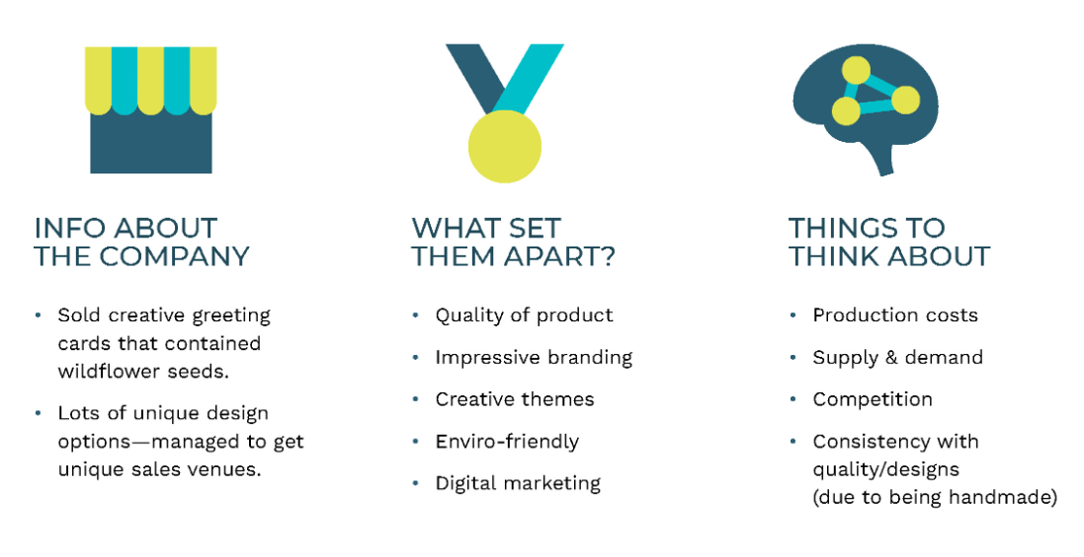
Product Inspiration
Notes:
OPTIONAL - IF TIME PERMITS - GREAT IF YOUR TEAM NEEDS SOME INSPIRATION FOR PRODUCTS!
A series of photographs have been collected to showcase previous products and JA student companies. Show the Product Inspiration slides to the group discussing the strengths and weaknesses of each one based on first impressions and limited information. How would the group classify each example – innovation or invention? Consider the following discussion questions:
a. Why are these innovations?
b. What problems were the Achievers trying to solve?
c. Do you think these products fill a need in the market?
d. Are these filling a customer "want" or a "need"?
e. What are some things that customers want?
f. What do these customers need?
g. How would you know the difference?
Spend time with groups or individuals discussing their ideas to get a sense of what might be presented during pitches.
Remind students about the Product and Service Checklist to ensure that their products qualify for the program.Discuss the selection process with students and review the Pitch Evaluation Criteria the group will use. Be sure to answer all questions students have and highlight that this is a very important decision for the company to be successful.

Slide 63

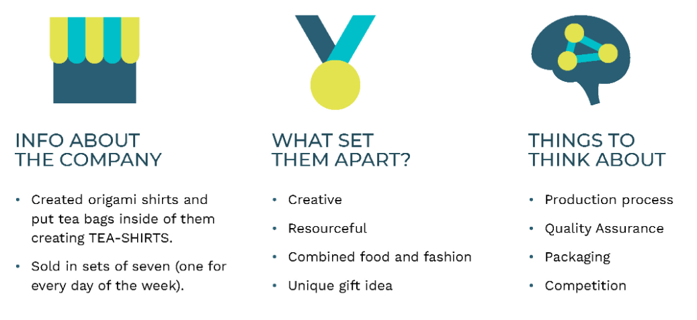
Product Inspiration
Notes:
OPTIONAL - IF TIME PERMITS - GREAT IF YOUR TEAM NEEDS SOME INSPIRATION FOR PRODUCTS!
How would the group classify each example – innovation or invention? Consider the following discussion questions:
a. Why are these innovations?
b. What problems were the Achievers trying to solve?
c. Do you think these products fill a need in the market?
d. Are these filling a customer "want" or a "need"?
e. What are some things that customers want?
f. What do these customers need?
g. How would you know the difference?

Slide 64
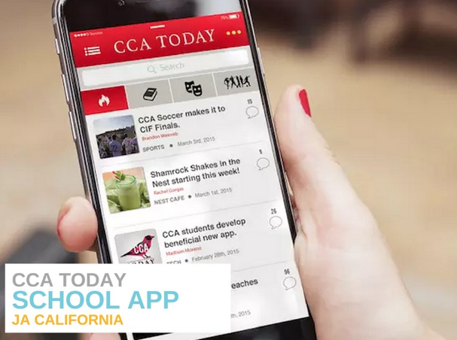
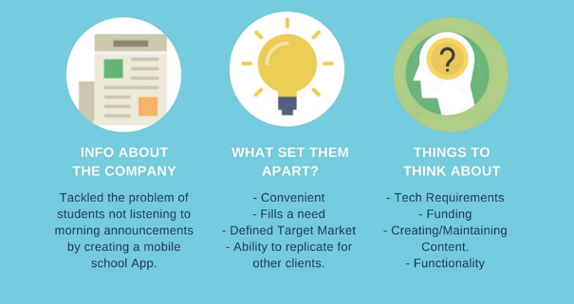
Product Inspiration
Notes:
OPTIONAL - IF TIME PERMITS - GREAT IF YOUR TEAM NEEDS SOME INSPIRATION FOR PRODUCTS!
How would the group classify each example – innovation or invention? Consider the following discussion questions:
a. Why are these innovations?
b. What problems were the Achievers trying to solve?
c. Do you think these products fill a need in the market?
d. Are these filling a customer "want" or a "need"?
e. What are some things that customers want?
f. What do these customers need?
g. How would you know the difference?

Slide 65

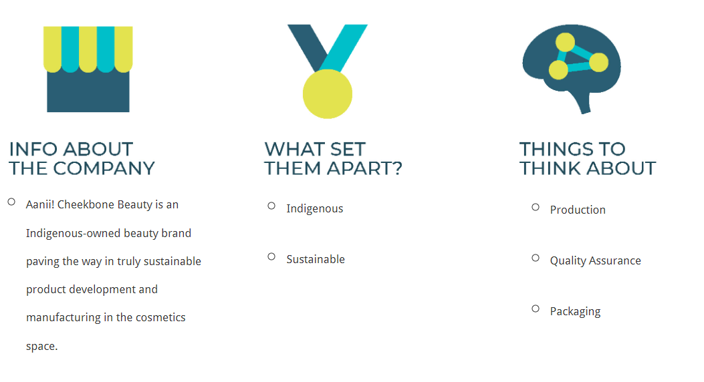
Product Inspiration
Notes:
OPTIONAL - IF TIME PERMITS - GREAT IF YOUR TEAM NEEDS SOME INSPIRATION FOR PRODUCTS!
How would the group classify each example – innovation or invention? Consider the following discussion questions:
a. Why are these innovations?
b. What problems were the Achievers trying to solve?
c. Do you think these products fill a need in the market?
d. Are these filling a customer "want" or a "need"?
e. What are some things that customers want?
f. What do these customers need?
g. How would you know the difference?

Slide 66

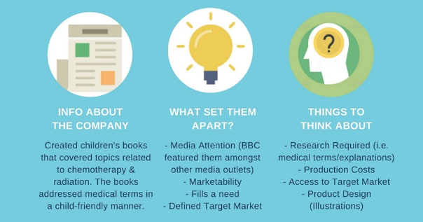
Product Inspiration
Notes:
OPTIONAL - IF TIME PERMITS - GREAT IF YOUR TEAM NEEDS SOME INSPIRATION FOR PRODUCTS!
How would the group classify each example – innovation or invention? Consider the following discussion questions:
a. Why are these innovations?
b. What problems were the Achievers trying to solve?
c. Do you think these products fill a need in the market?
d. Are these filling a customer "want" or a "need"?
e. What are some things that customers want?
f. What do these customers need?
g. How would you know the difference?

Slide 67

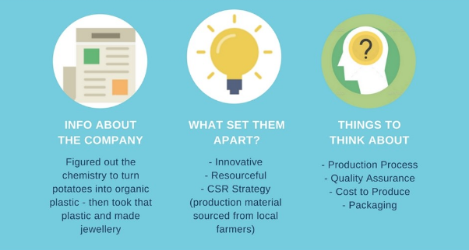
Product Inspiration
Notes:
OPTIONAL - IF TIME PERMITS - GREAT IF YOUR TEAM NEEDS SOME INSPIRATION FOR PRODUCTS!
How would the group classify each example – innovation or invention? Consider the following discussion questions:
a. Why are these innovations?
b. What problems were the Achievers trying to solve?
c. Do you think these products fill a need in the market?
d. Are these filling a customer "want" or a "need"?
e. What are some things that customers want?
f. What do these customers need?
g. How would you know the difference?
Spend time with groups or individuals discussing their ideas to get a sense of what might be presented during pitches.
Remind students about the Product and Service Checklist to ensure that their products qualify for the program.
Discuss the selection process with students and review the Pitch Evaluation Criteria the group will use. Be sure to answer all questions students have and highlight that this is a very important decision for the company to be successful.

Slide 68
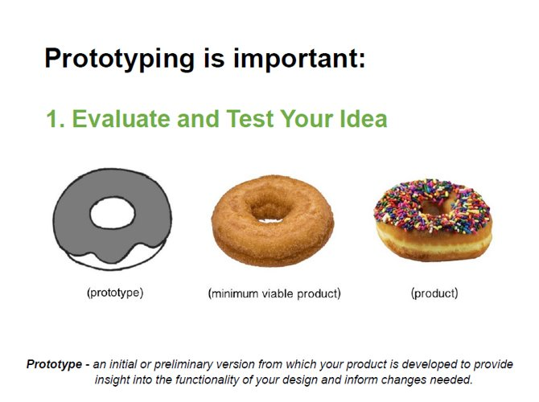
Prototyping
Prototyping is important:
1. Evaluate and Test Your Idea
prototype
Minimum viable product
product
Prototype – an initial or preliminary version from which your product is developed to provide insight into the functionality of your design and inform changes needed.
Notes:
As students are working through ideas, review with them the importance of preparing a prototype. A few Prototyping slides are available on the JA Canada Digital Campus. A prototype is defined as:
an initial or preliminary version from which your product is developed to provide insight into the functionality of your design and inform changes needed
The biggest benefit of prototyping is that it prevents important factors from being overlooked and it stops you making any assumptions that could be revealed as inaccurate later on in the process.
Prototyping is important for several reasons:
a) Evaluate and Test Your Idea
Ideas and drawings of a design can sometimes be a far cry from the real world in which the product will be used. By creating a prototype, it is possible to sit down with a preliminary version of the product vision and determine what works and what does not. Often glaring omissions emerge that, initially, weren’t obvious.

Slide 69
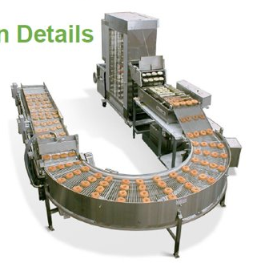
Prototyping
Prototyping is important:
2. Clarify Production Details
product
Prototype – an initial or preliminary version from which your product is developed to provide insight into the functionality of your design and inform changes needed.
Notes:
b) Clarifying Production Details
By prototyping before production begins, it is possible to take a glimpse at the production process and see if any steps can be changed, combined or even removed. This streamlines production and minimizes production costs. An idea without a prototype is just a theoretical concept. Prototypes often greatly enhance product pitches.

Slide 70

Prototyping
Prototyping is important:
3. Selling Your Idea
Prototype – an initial or preliminary version from which your product is developed to provide insight into the functionality of your design and inform changes needed.
Notes:
c) Selling Your Idea
It is also far easier to sell to potential customers when they can hold a prototype during your pitch. It can be difficult to get commitment with only a vague concept.
Students can create prototypes using materials around their house/school or purchase low cost materials or using online technology if available.

Slide 71
SMART Goals
SMART Goals Video
Notes:
Explain that as a Company students will eventually create goals together.
The students were already asked to create their own personal goals and share with the advising team
Ask the students if anyone wants to share their own goals
Let the students know that their goals may change throughout the program and that’s okay!
ADVISOR NOTE: Please be logged into the campus before clicking the video link.

Slide 72
Questions & Next Steps
Get ready for Elections or Product Pitches.
Watch the video Business Models on the JA Canada Campus
Notes:
(5 minutes)
Create an opening for students to ask any questions about the meeting prior to wrapping up.
Remind students executive elections are next week! If they would like to nominate themselves, they will have to let the advising team know and prepare.
Mentors:
Gather attendance records
Take a few moments to debrief about the session with the team of Mentors
If you were not able to cover any material, make a note and move it to your next meeting
Address any questions, concerns or feedback to your Program Manager

Slide 73
Company Program Cycle
This year, you will be able to choose whether you want to do your elections first or product selection first.
Make sure that both elections and product selections are completed no later than Week 4.
The earlier you have your product and executive team in place, the sooner the team can get their approval from JA and start their business.
Notes:
The weeks are currently structured to have elections first, and then product selection. Move the slides around depending on which you’re doing first.
IMPORTANT FOR 2024/2025:
Product Approval Form & Executive List are both due by Friday, November 29th (end of Week 4)
Please note:
Teams have the choice to complete their product selection OR their elections first this year.
It’s up to you and your team to decide which you’d like to complete first as long as both product selection and team elections are completed by Week 4.
We recommend that you do product selections and elections (in whichever order preference) in Weeks 3 (Week of Nov 18-22) and 4 (Week of Nov 25-29).
Brainstorming/Ideation + (must be completed by week 4):
You must allot time for the team to complete their product pitches AND complete the product approval form before the deadline of Friday, November 29th
Therefore, brainstorming/ideation can take place between weeks 1 to 3 and product pitches and selection should take place sometime between weeks 3 and 4.
If you need more time, you can request an extension to submit the product approval form by a week.
Often teams will have wished they selected their product sooner so that they could get started earlier so it’s not always necessary to take more time.
Executive Elections (must be completed by week 4):
You can opt to do your elections BEFORE or AFTER product selection this year. Elections must be completed by Week 4 (normally they are completed in Week 3 or 4 depending on what week you do your product selection). You must submit your executive list and organizational structure to JA no later than Friday, November 29th.
Student Management Training:
Student Management Training is IN-PERSON this year taking place at the BMO Academy (Yonge & Dundas)
Students elected to the 7 mandatory executive roles must attend this mandatory meeting (they can request for exemption if they have a valid reason and can appoint another student to attend in their place
JA must submit the names of attendees to the venue by Monday, December 2nd so the deadline to submit the executive names (November 29th) is a firm deadline.

Slide 74
PHASE 2
Unite
Notes:
Phase 2 Unite Participants unite ideas and people to form the leadership framework, innovative market solution, and business model to achieve the co-created mission.
Objectives
Understand the criteria for selecting the nature of the business venture, potential mechanisms for funding business ideas and product pitching
Establish the details of the student company using the business model canvas and clearly defi ne the proposed value proposition
Revisit the concept of leadership and define roles
Finalize the mission and establish the organizational structure
Establish the department functions and individual responsibilities to the team

Slide 75
Week 3 Agenda
Attendance
Icebreaker
Executive Team Selection
Determine the Executive Team and other roles
Employee Handbook
Student Management Training
Brainstorming
Questions & Wrap-up
Notes:
Overview
In this phase, students will identify executive roles and responsibilities as well as establish their leadership/executive team. Students will be involved in an inclusive environment where they are engaged, motivated, and committed. To ensure total student engagement, all company stakeholders that do not hold executive roles will be assigned a position including roles and responsibilities dependent on their skills and interests.
The team emerges from an inclusive leadership framework where students are engaged, motivated, and committed.
Objectives
Revisit the concept of leadership, learn about various leadership styles, and define roles.
Evaluate the department functions, roles, and responsibilities.
Establish roles for all stakeholders.
Finalize the mission and establish an organizational structure.
Mentor Preparation
Review videos and materials in advance on the JA Canada Campus
Prepare for the selection process chosen: print out ballots and Interview Process Questions for Candidates (if applicable)
Ensure you can access the Employee Handbook Template – either print a few copies or access online during the program
Note: All documents and videos referenced in the detailed instructions are available on the JA Canada Campus.
Agenda
Attendance (5 min)
Leadership Ice Breaker (20 min)
Selection process (60 min)
Determine Executive Team & all Stakeholder Roles (30 min)
Employee Handbook (15 min)
Executive Team Training (Outside Regular Hours)
Brainstorming (if time allows)
Wrap-up (5 min)

Slide 76
Ice Breaker
Notes:
Choose 1 of the Leadership Ice Breakers. This will allow students to do something fun prior to the selection process and also provide a final opportunity to review important leadership qualities.

Slide 77
Executive Elections
Order of Elections
President
VP Finance
VP Marketing
VP Sales
VP Production
VP Human Resources
VP Technology
Notes:
Selection Process (60 Mintues)
Conduct your Selection Process at the beginning of the meeting, to allow enough time for all candidates.
Provide details on the online ballots so students have them on hand for the speeches or panel interview process. Refer to the F25 JA Company Program Elections Rubric For Printing
Vote for the Executive team in the following order:
President
VP Finance
VP Marketing
VP Sales
VP Production
VP Human Resources
VP Technology
The following positions are optional:
VP Corporate Social Responsibility
VP Health & Safety
VP Environment
Best practice tips: Consider advising students on limiting the number of positions for which they run. Running for multiple positions could cause other participants to question the true intentions of the candidate. Optional positions should be determined based on company size and student interest. Please keep in mind that students will take on non-executive leadership roles in their department of interest.

Slide 78
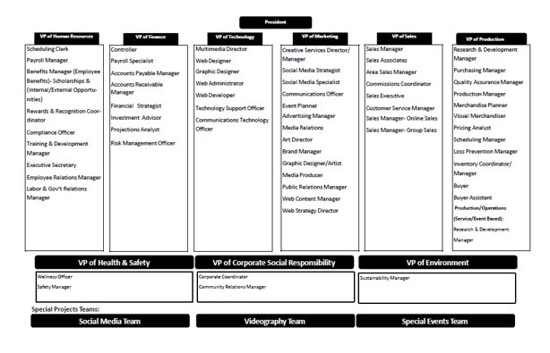
Executive Elections
Organizational Structure Template
Notes:
Determine Executive Team & all Stakeholder Roles (30 min)
Once the executive team is determined, you will work with department heads and remaining non-executives to determine where remaining stakeholders would fit best into the organization based on their self-assessment and their interest in the functional areas and roles
Non-executives migrate to the department in which they are interested.
Stakeholders then discuss possible positions with the department head and other interested stakeholders (Refer to the All Functional Area Roles document)
Every student must work with their team to determine a job title for themselves.
Examples are given of possible positions, but stakeholders are able to take the initiative and develop their own personalized position – ultimately each stakeholder in the company should have a role, function, and accountability (this also applies to advisors)
If a social media account is to be used for communications purposes outside of the weekly meetings (group chats etc) emphasize the need for keeping all Company information/data and conversations private to only Company members, is to be reinforced.
In the Organizational Structure Template, students should list all roles and names – This should be finalized and mapped out before the end of this meeting. (please be signed into the JA Campus before clicking the link.
Mentorship Notes:
After the elections, there will understandably be some students who are disappointed and discouraged.
Play close attention to these students as they may need a boost in morale!
You may want to meet with these students in a smaller group and encourage them. Let them know that not all leaders have a “President” or “VP” title. In fact, in Company Program, some of our most successful students did not hold these titles.
You may want to share a personal experience with the team if you have one to share about not getting a role/position you wanted and how you overcame it.
Remind all students that no matter what their title or role is, they will play an integral role in leading their company to success.

Slide 79
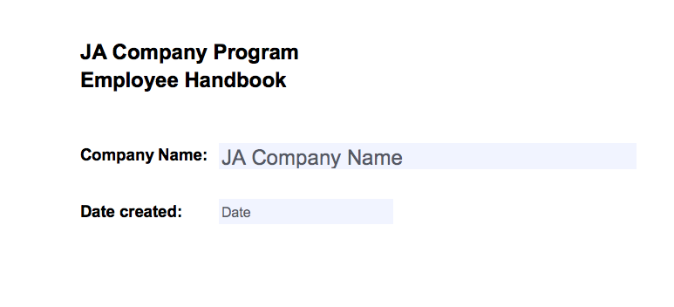
Employee Handbook
JA Employee Handbook
Notes:
Employee Handbook (15 min)
An Employee Handbook is a document that includes information that employees may need to refer to frequently in order to meet the terms and conditions of their employment. Having established policies will help eliminate confusion of what is expected from everyone.
Take the time to introduce briefly the Employee Handbook Template (and advise students to consider how they will modify the handbook to meet their company requirements). Review as a group the Code of Ethics and Test of Disclosure elements contained in the handbook to emphasize their importance.
The VP of HR will oversee the creation of the Employee Handbook which will be due in Week 6. The VP of HR will collect the signed Code of Ethics agreement to keep as a record.

Slide 80

Student Management Training
Saturday, December 7th
In-Person Event
BMO Academy
Downtown Toronto
Mandatory Event for all 7 Mandatory Student Executives!
JA will follow up with details regarding the event.

Slide 81
Brainstorming
Notes:
IF TIME PERMITS
Allow students to continue brainstorming and working on their product pitches

Slide 82
Questions & Next Steps
Go to the JA Canada Campus and review the Department Responsibilities document as well as the resources available by department in preparation for Phase 4: Build.
Notes:
Congratulate students on successful elections and forming their teams. This is a great accomplishment.
Encourage students, especially the Management Team, to go to the JA Canada Campus and review the Department Responsibilities document as well as the resources available by department in preparation.
Mentors:
Gather attendance records – attendance can now be passed onto the VP of HR but advisors will need monitor
Take a few moments to debrief about the session with the team of Mentors
Review Department Responsibilities and the Record Keeping Tool in preparation for the next phase
Address any questions, concerns or feedback to your Program Manager

Slide 83
Week 4 Agenda
Attendance
Snake Oil Icebreaker
Idea Pitches
Business Model Canvas
Company Mission
Venture Funding
Questions & Wrap-up
Notes:
Overview
In this Phase, students will pitch their ideas and vote on a product/service then begin to develop their business plan and determine venture funding.
Objectives
Identify different leadership styles and strengths.
Understand the criteria for selecting the nature of the business venture and product pitching.
Establish the details of the student company using the business canvas model.
Understand potential mechanisms for funding business ventures.
Mentor Preparation
Review videos and materials in advance on the JA Canada Campus
Ensure there are a computer, projector and speakers available. The Record Keeping Tool may be useful. Access it as needed.
Read through Snake Oil Activity and print out the attached Snake Oil Cards.
Print out a copy for each student of the Pitch Evaluation Criteria and Company Ranking (if applicable).
Print out a few copies of the Capitalization Requirements exercise.
Note: All documents and videos referenced in the detailed instructions are available on the JA Canada Campus.
Agenda
Attendance (5 min)
Snake Oil – Ice Breaker (15 min)
Idea Pitches (45 min) ---- if the team is ready ---- if not, continue brainstorming/working on pitches
Business Model Canvas (45 min)
Company Mission (30 min)
Venture Funding (25 min)
Wrap Up (5 min)

Slide 84
Ice Breaker
Snake Oil
Pitch Your Product Icebreaker
Notes:
OPTIONAL: This icebreaker can be done as a full team or in smaller groups to allow more participation from students.
You can do the Snake Oil icebreaker or choose another one of your choice!

Slide 85
Snake Oil
The game's object is to imagine a product/service from a random selection of words and pitch that product/service to a particular customer segment.
Step One:​
Select any 6 words from the following list & write them down on a piece of paper ​
(1 Minute)

Slide 86
Snake Oil
AIR​
BACK​
BANANA​
BELLY​
BICYCLE​
BIRD​
BLADE​
BUTTER​
CANOE​
CART​
CAT​
CHAIR​
CHEETAH​
CLIP​
CLOCK​
COMB​
COMPUTER​
COW​
DONUT​
ELASTIC
FACE​
FIRE​
FIRE​
FISH​
FOOT​
FORK​
HAIR​
HAND​
ICE​
JEANS​
KEY​
KITTEN​
LETTER​
MAGIC​
MAKER​
NAIL​
PAPER​
PHONE​
PICTURE​
PLUSH​
PORTABLE​
PUMPKIN​
RAKE​
RING​
SCREAM​
SHIRT​
SHOE​
SLEEP​
SONG​
STAPLE​
SUN​
TABLE​
TIME​
TONGUE​
TOOTH​
TRAIN​
TREE​
VALLEY​
WATER​
WIND

Slide 87
Snake Oil
STEP TWO: ​
From your list, choose two that, when combined, could be an appealing product to sell. This is the name of your product/service.

Slide 88
Snake Oil
STEP THREE: ​
Now each student will take turn acting as the customer indicated in the following slides.
Other students will take a maximum of 30 seconds each to pitch your product.
Note: If someone has already pitched your two words, you must choose another combination.

Slide 89
Snake Oil
STEP FOUR: ​
The student acting as the customer will be able to select one product/service to buy.

Slide 90
Snake Oil
READY?
Select your first student to be the customer and click to the next slide...& get ready to pitch!
Notes:
Note to advisors: If you do not want students to see the whole customer list at one time, do not switch to next slide and simply call out one of these customers from the list or make up your own!

Slide 91
Snake Oil
STAY AT HOME DAD
ASTRONAUT
ALIEN
RACECAR DRIVER
HITCHHIKER
LUMBERJACK
FISHERMAN
MOUNTAINEER
FASHION MODEL
GAMER
HIPSTER
CLOWN
SOCIAL MEDIA INFLUENCER
GRANDMOTHER
AUTHOR
PERSONAL TRAINER
QUEEN
PRIME MINISTER
FOOD BLOGGER
Notes:
Debrief and wrap up after 15 minutes.

Slide 92
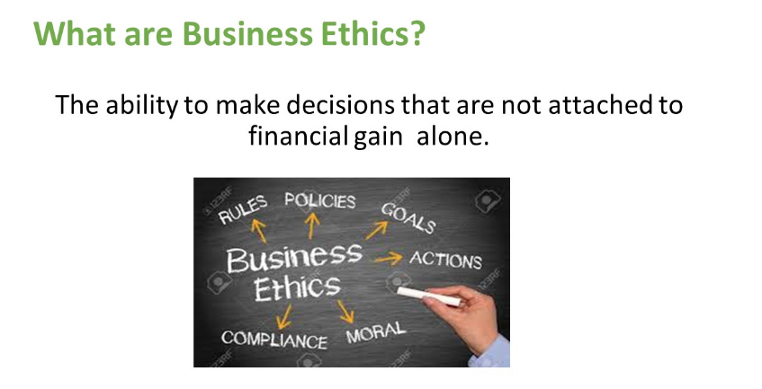
Business Ethics & Test of Disclosure
Notes:
OPTIONAL – can be moved to a later meeting
Review the following Business Ethics & Test of Disclosure slides with the students. The goal of this section is to help students:
Define Business Ethics and why it is important
Provide students with two ways they can use to make decisions: Test of Disclosure or P.L.U.S.
Please note: Students are not required to come up with their own “Code of Ethics”. They are required to understand that the role ethics plays in their company decisions and adhere to using the Test of Disclosure and/or P.L.U.S. model in their decision making. They will sign off on this agreement as part of their employee handbook and Code of Ethics Employee Agreement.

Slide 93
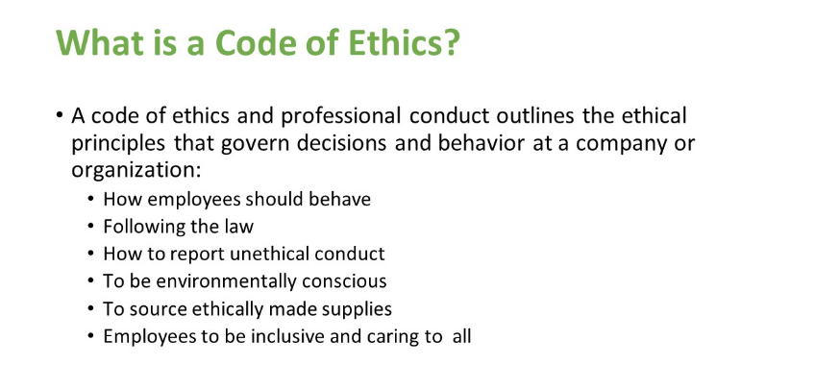
Business Ethics & Test of Disclosure
Notes:
OPTIONAL – can be moved to a later meeting

Slide 94
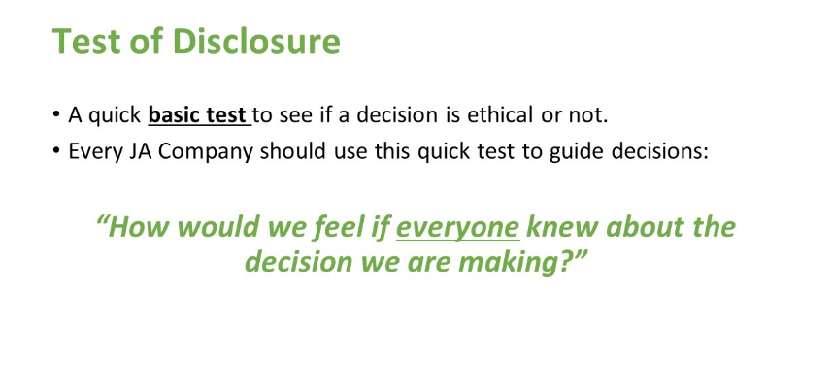
Business Ethics & Test of Disclosure
Notes:
OPTIONAL – can be moved to a later meeting

Slide 95
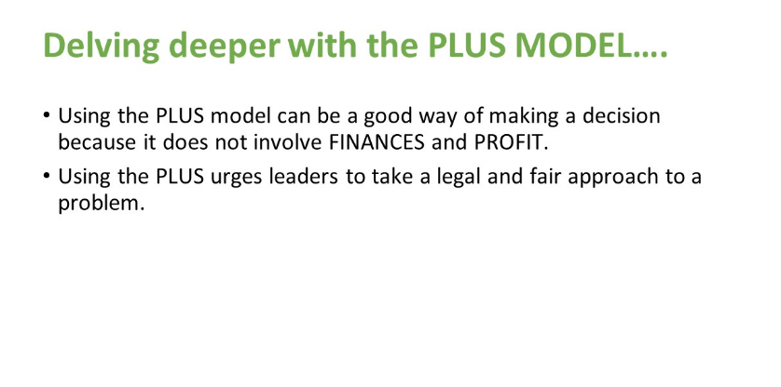
Business Ethics & Test of Disclosure
Notes:
OPTIONAL – can be moved to a later meeting

Slide 96
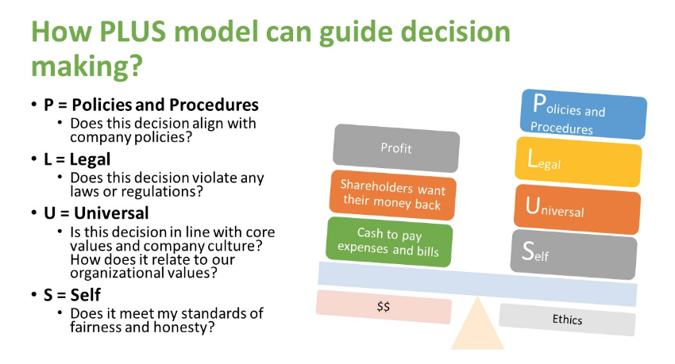
Business Ethics & Test of Disclosure
Notes:
OPTIONAL – can be moved to a later meeting

Slide 97
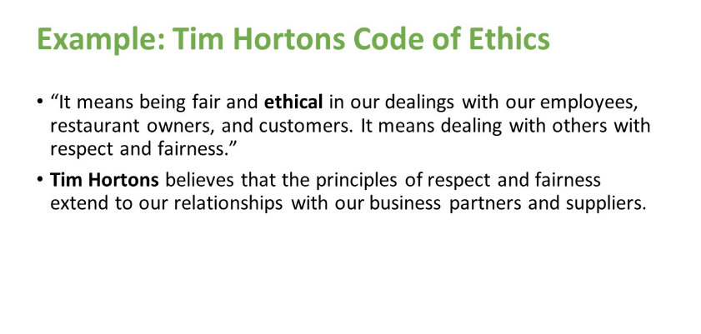
Business Ethics & Test of Disclosure
Notes:
OPTIONAL – can be moved to a later meeting

Slide 98
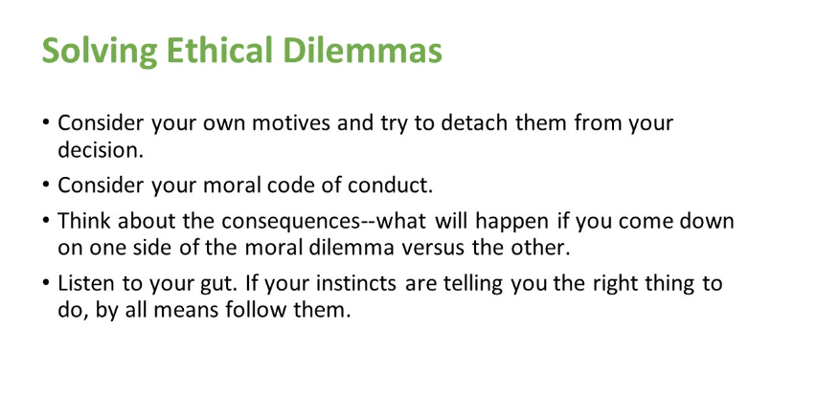
Business Ethics & Test of Disclosure
Notes:
OPTIONAL – can be moved to a later meeting

Slide 99
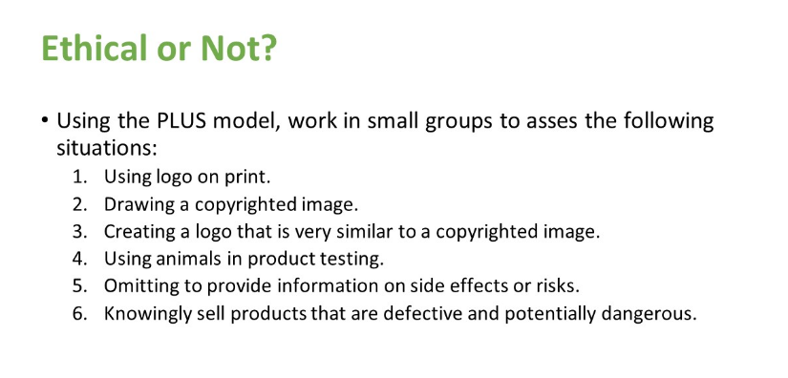
Business Ethics & Test of Disclosure
Notes:
OPTIONAL – can be moved to a later meeting

Slide 100
Idea Pitches!
Notes:
Idea Pitches (45 min)
Explain that participants will now present their pitches that they prepared at home, and the group will vote on the product/service idea that will be used moving forward. Reminder: only groups/individuals with fully formed and researched ideas will pitch.
Before the pitches, thank everyone that put time into developing an idea. Remind the group that every idea has value and respect should be displayed.
Review the criteria for judging with the group.
Number students/groups and then draw a number to announce who will pitch.
Keep the time limit to a maximum of 1 minute for each pitch. Questions are allowed after the pitches but keep them to a minimum.
Email and distribute the Pitch Evaluation Criteria worksheet in advance to students. Ask students to listen to each pitch before recording points. Once they have completed the scoring, they can enter their votes anonymously using an online voting tool suggested by your charter.
Mentors will review scores and narrow down to the top 2-3 products. To determine the final idea, lead the group in an open pros and cons discussion about the top 2-3 chosen products/services. This will allow them to explore in more details the viability of the product/service and identify potential challenges. Once the discussion is done, the group can do a show of hands for the products/services or judge again using another method.

Slide 101









Business Model Canvas
Use the Business Model Canvas to start expanding your business ideas.
https://www.youtube.com/watch?v=QoAOzMTLP5s
Key Partnershi
ps and Relationships Key Activities Mission and Value Proposition Customer Relationships Customer Segmen
ts
What will you get other groups to do so you can focus on the Key Activities?
What uniquely strategic things will your business do to deliver value?
What’s compelling about your proposition? Why will customers buy or use?
How will you interact with the customer?
Who are the customers? What do they think? See?
Feel? Do?
Key Resources, Materials, Supplies
What unique strategic assets must the business have to operate?
Corporate Social Responsibility
Channels
How will you promote, sell, and deliver?
Will you be using the Test of Disclosure to ensure your business will be ethical?
Are you considering affiliating your business with a charitable organisation?
Fixed and Variable Costs
What are necessary expenses for operating your business?
Revenue
How will the business make money? Are there multiple revenue streams?
Notes:
Business Model Canvas (45 min)
https://www.youtube.com/watch?v=QoAOzMTLP5s
Start this activity by having a discussion about why companies are successful. Are goals and strategy important? Why?
Bring students back to the concept of SMART goals explored in Week 2.
Explain that in order to be successful, they must put some time into planning. Together they will complete a Business Model Canvas. The Business Model Canvas will give them the structure of a business plan and fundamentally delivers three things:
Focus: everyone will be on the same page
Flexibility: easy to tweak the model and try new things
Transparency: the team will have an easier time understanding the business model

Slide 102

Business Model Canvas
Lean Business Start-Up
Build – Measure – Learn
Notes:
Just like any other business, tell them that ensuring that their product/service and company are successful requires a process of evaluation throughout their operations. Discuss the concept from lean business startup called “Build-Measure-Learn” and show the Build-Measure-Learn slides from the JA Canada Campus. Ask the students, how could we apply this process to our company? What questions in the “Measure” section could we ask based on the product/service we’ve chosen?
Watch the Business Model Canvas – The Lean Playbook video on the JA Canada Campus with students to understand the 9 segments of the Business Model Canvas.
Help students begin to complete their Business Model Canvas using the template provided. Students will have an opportunity to complete this in Phase 3.
Option: Divide up the sections so students can work on it in smaller groups. At your next session, each group can present their sections to the team.

Slide 103
Build, Measure, Learn
There are three important steps in creating and maintaining a successful venture:
Build
Learn
Measure

Slide 104
Build, Measure, Learn
Build
Form the company
Create a team
Make a product/service

Slide 105

Build, Measure, Learn
Measure
How many sales are being made?
How efficient is production?
How effective are our employees?

Slide 106

Build, Measure, Learn
Learn
What can we take from what we've measured?
How do we improve?
What is working, what's not?

Slide 107

Build, Measure, Learn
A successful company is one that is constantly
re-evaluating itself

Slide 108
Build, Measure, Learn
By following Build – Measure – Learn, you'll be able to adapt quicker and keep your customers happy!
Build
Learn
Measure

Slide 109
Business Model Canvas
Business Model Canvas – The Lean Playbook video: https://youtu.be/PIXmx03sCpU

Slide 110

Company Mission
A company’s mission statement is their opportunity to define the company’s goals, ethics, culture, and norms for decision-making. ​
​
The best mission statements define a company’s goals in at least three dimensions: ​
What the company does for its customers​
What it does for its employees​
What it does for its owners​
Other mission statements also include what the company does for its community and for the world.
Notes:
Company Mission (30 Minutes)
You can move this to following week if you run out of time.
Now that a product/service has been chosen, it is time to think about the Company Mission, Goals and Vision
Your company’s mission statement is your opportunity to define the company’s goals, ethics, culture, and norms for decision-making. The best mission statements define a company’s goals in at least three dimensions: what the company does for its customers, what it does for its employees, and what it does for its owners. Other mission statements also include what the company does for its community and for the world.
Facilitate a discussion using the following questions:
“Who” is your company?
What do you do? What do you stand for? And why do you do it?
Do you want to make a profit, or is it enough to just make a living?
What markets are you serving, and what benefits do you offer them?
Do you solve a problem for your customers?
What kind of internal work environment do you want for your employees?
Ask a student to take notes since they will need to refer back to this discussion in Phase 3 when the Mission Statement Template must be completed by the President.

Slide 111

Venture Funding
Notes:
*AGENDA NOTE* You can move this to the week following idea pitches if you run out of time.
Now that the product(s) or service(s) have been chosen it is time for the group to determine their capitalization needs.

Slide 112
Venture Funding
JA Companies typically gain
start-up funding through the sale of shares.

Slide 113
Venture Funding
Initial share value can be between $5.00 and maximum $30.00.
Companies may choose to sell common shares only or both common and preferred shares.
Notes:
IMPORTANT TO NOTE TO STUDENTS: If there are circumstances which would prevent a participant from purchasing a share they should speak with their mentor team and/or Company Program Lead to make alternate arrangements. Such conversations will be held in strictest confidence.
Let the students know they can email Lucia at lly@jacentralontario.org privately if they do not wish for their advisors to know any personal circumstances.

Slide 114
Venture Funding
Common Shares
Participate in the profit share of the company
Entitles the holder to voting privileges.
The purchase price is set by the Company; value at liquidation will depend on profitability of the company.
Only students in the company can purchase a common share.

Slide 115
Venture Funding
Preferred Shares
Do not participate in the profit share or have voting privileges.
These shares are treated as a company expense and the face value (determined by the Company) plus dividend (20%) must be paid at liquidation.
These shareholders will be paid out first during company liquidation.
These shares can be sold to: Advisors, Family, Businesses, etc.
The Company must vote to issue preferred shares and a majority must be in favour.
A maximum of $300 can be raised through preferred shares.
Notes:
Each company member must purchase a common share in the company to be an active company member with voting privileges. Members can also purchase one additional preferred share. If there are circumstances which would prevent a participant from purchasing a share they should speak with their mentor team and/or Company Program Manager to make alternate arrangements. Such conversations will be held in strictest confidence.
Companies must complete the Capitalization Requirements exercise to determine the funding needed for start-up. Prior to this, they must complete their break-even analysis.
Refer to the product/service cost, break even and pricing tools provided by your program manager to determine these numbers.
Companies should avoid over or under capitalization. Each company can raise a maximum of $300.00 for the purpose of capitalization (total combination of common and preferred). If additional start-up funding beyond $300 is required, the company must contact the Program Manager to obtain approval.
If the capital requirements exceed the revenue from the common share purchase, companies may choose to offer preferred shares to individuals outside the company membership (this may include volunteer mentors). The Company must vote to issue preferred shares and a majority must be in favour.

Slide 116
Venture Funding
No single student individual should own more than one common share and
one preferred share in any one JA Company.
Notes:
No single individual should own more than one common share and one preferred share in any one JA Company. Shares are non-transferable and non-legal. It is important to review the ethics behind buying another member’s share and not telling anyone you have done so. This does not pass the Test of Disclosure attached to the Code of Ethics (Would everyone be okay with the decision you are making?)

Slide 117
Venture Funding
What happens when a student leaves the program after purchasing a share?​
​The company should decide and agree on what the policy is for a participant who leaves the program and include the agreement in their Employee Handbook and Company By-Laws.​
​
Option 1:​
If a participant leaves the Company Program after purchasing a common share, that share will become a preferred share, payable at year-end with dividend.​
​
Option 2:​
If a participant leaves the Company Program after purchasing a common share, they forfeit their share money and are not entitled to profit-sharing or year-end dividend.
Notes:
If a participant leaves the Company Program after purchasing a common share, that share will become a preferred share, payable at year-end with dividend. Any extenuating circumstances should be discussed with the Program Manager.

Slide 118

Venture Funding
It is essential that complete and accurate shareholder records are maintained. The following must be recorded:
Full Name​
Mailing Address ​
Email Address​
Phone Number
Notes:
It is essential that complete and accurate shareholder records are maintained. The full name, mailing address, email address and phone number for all shareholders must be recorded.

Slide 119
Venture Funding
BREAK-EVEN ANALYSIS​
​
Teams must complete the break-even analysis before completing the capitalization requirements. ​
​
Refer to the break-even analysis in the Record-Keeping tool before completing the initial capitalization calculation sheet.
Notes:
Refer to the product/service cost, break even and pricing tools provided by your program manager to determine these numbers.

Slide 120
Venture Funding
Capital is money, machinery, tools, equipment, and buildings that businesses need for operation. JA companies obtain operation capital by selling shares.
Overcapitalization When a corporation raises more money than it needs. Overcapitalization is wasteful because it represents assets that may have been used elsewhere to produce wealth. It also creates an unnecessary burden on a company because it must pay dividends to investors it did not need in the first place.
Undercapitalization Undercapitalized firms are those with insufficient funds to meet their current expenses. In such a situation a company must find a way to raise additional funds, or face bankruptcy.
Initial Capitalization This is the amount of money required to start the business.
Notes:
Note to Advisors:
Please refer to each charter's process on setting up a bank account. Once the account has been set up, students should be encouraged to e-transfer their share money.
Other means of funding: Teams may be permitted to seek out sponsorship opportunities for their company. Seek clarification from your program manager about how this is to be managed.
Appropriate “services in-kind up” should not exceed the total share value raised (max $300)
Examples of sponsorship opportunities have included:
In-kind listing/promotion of the students' product/service on the sponsor's website
In-kind service provided by sponsor (i.e. marketing, design, etc.)
Getting Digital coupons from a retailer to include in their sale with their product.
Sponsorship needs to be acknowledged by the company on print materials and your local JA Charter needs to be aware of all sponsorship deals.
It is important to note that it is very tempting to take donations of free supplies that might exceed the $300 total share value limit. Again, using the Test of Disclosure is an important check in to see if the Code of Ethics is being abided by.

Slide 121
Questions & Next Steps
Start sending in share money
If there are circumstances which would prevent a participant from purchasing a share they should speak with their mentor team and/or Company Program Manager to make alternate arrangements. Such conversations will be held in strictest confidence.
Notes:
If the capitalization is complete and the bank account has been set up, share the process for e-transfer and encourage students to start sending in their share money before your next meeting.
Mentors:
Gather any outstanding forms and attendance.
Set up Bank Account if not done

Slide 122
PHASE 3
Build
Notes:
Phase 3 Building a new business requires a strong foundation based on planning, strategy and communication.
Objectives
Create an accountability framework and department work plans
Develop and establish Key Performance Indicators (KPI) and department work plans
Quantify start-up capital needs, resources, and break-even point
Create the Lean Business Plan (if applicable)

Slide 123
Week 5 Agenda
Attendance
Ice-breaker
Review Business Model Canvas, Mission Statement
Key Performance Indicators
Business Planning – Lean Business Plan
Company Meetings
Product Approval
Record Keeping
Questions & Wrap-up
Notes:
Mentor Notes:
Review the attendance procedure with the VP HR and his/her team as they should now be responsible for taking weekly attendance. Attendance should still be monitored by the advisors.
Overview
Building a new business venture requires a strong foundation based on planning, strategy, and communication. In this phase, students review the Business Model Canvas, Mission Statement as they create Key Performance Indicators and work plans for each department. Success in this phase requires group negotiation and understanding the importance of delegation.
Optional:
Students work with their team to incorporate their Business Model Canvas sections into the respective sections of their Lean Business Plan, incorporate their Mission Statement into the plan and gather the materials still needed to effectively complete it. This involves delegation of sections and tasks to team members and problem solving. A completed business plan is compiled using the Business Plan template. Students are expected to use their business plan throughout the program to guide their venture.
After creating the Lean Business Plan, students should create an Employee Handbook using the sample guidelines and employee roles and responsibilities template for reference. A template for a Formal Business Plan is also provided for those who wish to use it.
Objectives
Create an accountability framework that incorporates the Code of Ethics, and department work plans.
Develop and establish Key Performance Indicators (KPI) and department work plans. Use of the Test of Disclosure as an aid to being transparent with all decisions is to be reviewed.
Verify start-up capital needs, resources, and break-even point.
Create the Lean Business Plan
Mentor Preparation
Review videos and materials in advance on the JA Canada Campus
Ensure that computers/laptops are available for planning purposes. Ideally, one computer/laptop per department.
If technology is not available, print out a copy for each department of the KPI Worksheet, Work Plan Template and Department Responsibilities. Also print out the Product or Service Approval Check-list
Note: All documents and videos referenced in the detailed instructions are available on the JA Canada Campus.
Agenda
Attendance (5 min)
Icebreaker (15 min)
Review Business Model Canvas, Mission Statement and Code of Ethics (Test of Disclosure) (10 min)
Key Performance Indicators (30 minutes)
Business Planning + Lean Business Plan (60 min)
Company Meetings (15 minutes)
Product Approval (15 minutes)
Record Keeping (30 minutes)
Wrap-Up (5 minutes)

Slide 124
Ice Breaker
Notes:
Choose an icebreaker or ask the executive team to lead their own!

Slide 125


Review
Business Model Canvas
Mission Statement
Code of Ethics/Test of Disclosure
Notes:
Take a few moments to review the Business Model Canvas, Mission Statement and Code of Ethics/Test of Disclosure created and discussed last week as this will re-energize the group and help with business planning.

Slide 126
Key Performance Indicators
KPI Video: https://youtu.be/1JxHMZLyuZw
Notes:
Key Performance Indicators (20 min)
Performance indicators are metrics used to measure the success of a business.
Before being able to determine what your KPI should be, it is important to ensure your organization has a defined business process, clear objectives for the business process, quantitative and/or qualitative data around results, an approach for identifying and correcting variances to achieve goals.
The importance of using the Test of Disclosure in an effort to be ethical should be reviewed and discussed regularly. If participants answer ‘No’ to the Test of Disclosure, refer them back to the Code of Ethics for discussion
Important first steps
Now that you have a product/service, your company structure is already in place, and you have a business plan (Business Model Canvas), you should already have a good idea of your start-up capital needs.
The next step is ensuring you’ve landed on a correct break-even point for your business. To do that, you can refer back to the capital needs, resources, and break-even point worksheet created earlier.
Watch the KPI Video on the JA Canada Campus.
It’s also critical to determine what Critical Success Factors (CSF) you expect. This can be on the production side (e.g. making X should cost $X per unit) or on the sales side (e.g. we should be able to sell X for $X per unit). There are many possibilities, but the most important determiner should be what the key requirements are for your business’s success.
Use the KPI Worksheet to work with your team to negotiate the details of company critical success factors, and work from the determined factors to create key performance indicators.
Once you’ve identified CSF and began tracking the KPI, the process becomes one of identifying shortcomings in your business processes vis-a-vis expected results, and develop methods of addressing and overcoming those shortcomings.
In the off chance that your business is meeting all its requirements for success, don’t rest just yet. You can also use KPI to improve on good-enough results to try and maximize profitability. That is the ongoing aspect of using KPI.

Slide 127
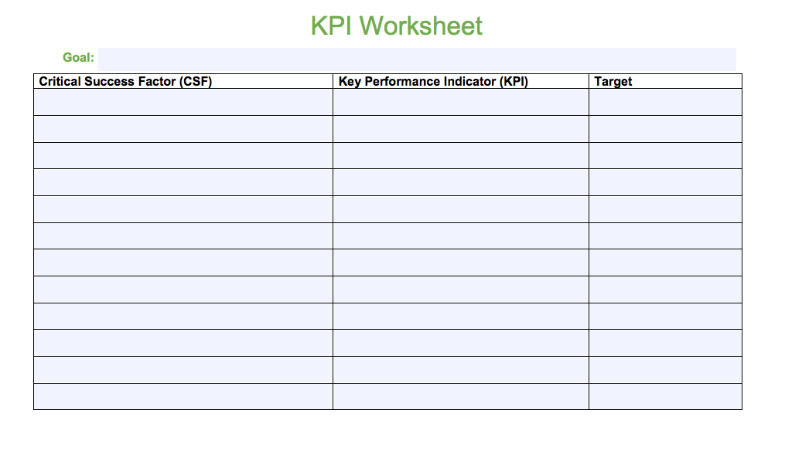
Key Performance Indicators
Key Performance Indicator Worksheet
Notes:
It’s also critical to determine what Critical Success Factors (CSF) you expect. This can be on the production side (e.g. making X should cost $X per unit) or on the sales side (e.g. we should be able to sell X for $X per unit). There are many possibilities, but the most important determiner should be what the key requirements are for your business’s success.
Use the KPI Worksheet to work with your team to negotiate the details of company critical success factors, and work from the determined factors to create key performance indicators.
Once you’ve identified CSF and began tracking the KPI, the process becomes one of identifying shortcomings in your business processes vis-a-vis expected results, and develop methods of addressing and overcoming those shortcomings.
In the off chance that your business is meeting all its requirements for success, don’t rest just yet. You can also use KPI to improve on good-enough results to try and maximize profitability. That is the ongoing aspect of using KPI.

Slide 128
Business Planning
Utilize the following resources for success
Department Responsibilities
KPI Worksheet
Work Plan Template
Resources Available by Department
Lean Business Plan template
Notes:
Business Planning (50 min) Log into the JA Campus to ensure links work.
Using the Department Responsibilities document and KPI worksheet, break students out into their teams so they can review each department’s responsibilities and start to create a work-plan using the Work Plan Template.
Encourage teams to look at their check-lists and break downs tasks into small steps with measurable timelines then enter them into their Work Plan Template. Remind them of SMART goals.
Provide each team with the Resources Available by Department document. Allow each department to view any videos or Power Point presentations available to them on the JA Canada Campus as part of their planning. Remind the Leadership team to review what the Test of Disclosure is with their departments.
The VP HR should oversee the creation of the Employee Handbook, due in Week 6.
Monitor each group to listen in on the planning and provide input or directions as this is their first planning opportunity.
Bring the group back together and ask each VP to highlight key objectives for their team with timelines. If any decisions have been made that do not seem clear, help the group use the Test of Disclosure as a guide.
Creation of Lean Business Plan (if applicable, 10 minutes)
Review the requirements described in the Lean Business Plan template.
Begin to import information from the mission statement and Business Model Canvas into the Lean Business Plan template.

Slide 129

Company Meetings
Sample Agenda Items
    President’s report​
    Report from each department including goals for the session/week, challenges, successes, update​
    Open forum: opportunities for members to ask questions, identify challenges and successes, discussion of issues that may have arisen leading from changes that may have to be made due to Test of Disclosure.​
    Upcoming items such as deadlines, sales opportunities, etc.
Will be led by the Management Team.
Will provide the Company with an overview of:
Progress to date
Challenges
Success and goals
Open forum for input
*Agenda to be created by the President
Notes:
Explain that starting next week, each session will begin with a short business meeting led by the Management Team.
The purpose of this meeting is to provide the Company with an overview of progress to date challenges, success and goals as well as provide an open forum for input.
The President is responsible for creating an agenda to be used for these meetings.
Suggested agenda items include:
President’s report
Report from each department including goals for the session/week, challenges, successes, update
Open forum: opportunities for members to ask questions, identify challenges and successes, discussion of issues that may have arisen leading from changes that may have to be made due to Test of Disclosure.
Upcoming items such as deadlines, sales opportunities, etc.
Explain that a formal Interim Status Meeting will be required in Week 8 and the Management team should review the Sample Meeting Agenda for Interim Status Meeting in advance to prepare.

Slide 130
Product/Service Approval
Before production can begin, the President, VP of Production and a JA Volunteer must complete the
Product or Service Approval Form
Notes:
Product/Service Approval (15 min)
Once all research and prototyping has been done for the product/service, the team must complete the Product Approval Form. The form can be completed with the President and VP Production. This must be done and approved before production begins.
Remind the team that they should not be ordering any supplies until they have received approval from JA.

Slide 131
Record Keeping Review
Notes:
Record Keeping Review (10 minutes)
Each Company is responsible for accurate record keeping.
A Record Keeping Tool is available on the JA Canada Campus.
The excel document should be downloaded in a way that it can be accessed by multiple members of the team. Google Drive or other online platforms could be used.
The document MUST be shared with the JA Program Manager so they may also monitor record keeping and provide assistance as needed.
The finance, human resources, sales and production departments each have weekly inputs with regards to record keeping. Encourage students to do this immediately following the Company Meeting.
Reinforce the importance of being honest, transparent and accurate with all record keeping.
Students can view instructional videos about the Record Keeping Tool in the JA Canada Campus.

Slide 132
Questions & Next Steps
It is highly encouraged that production is ready to test their production process next week as long as the Product/Service Approval Form has been submitted and approved.
Notes:
Wrap-up (5 min)
Create an opening to allow students to ask questions or provide feedback on how they are feeling to date.
Let students know that they will have an opportunity to continue planning next week with the goal of starting production no later then Week 7. If they are ready to begin next week they may do so.

Slide 133
PHASE 4
Launch
Notes:
Please note: If your team hasn’t completed all of the agenda items in Week 5, you can use week 6 to finish these elements. Refer to the previous phases for the instructions of these items.
If you are pushing agenda items back, please make sure that your team completes the items in Phase 3 by the end of week 6.
If your team has completed these items by week 6 you can proceed to phase 4 as outlined below.
Phase 4 Launch Successful entrepreneurial ventures are results of efficient production, compelling sales and accurate metrics.
Objectives
Implement the strategy defined by the Business Model Canvas and/or Lean Business Plan and apply department work plans
Continue production or product or marketing of service
Conduct sales
Maintain accurate records

Slide 134
Week 6 - 15 Agenda
Attendance
Company Meetings
Conduct Business Operations
Monitor Company Success
Plan for and conduct Interim Status Meeting
Wrap Up
Notes:
Overview
In this phase, all teams begin to implement their plan and begin to make their goals reality. Many activities are ongoing. Time indicated is time to review the material and conduct formal activities related to the business process.
Objectives
Implement the strategy defined by the Business Model Canvas and/or Lean Business Plan and apply department work plans
Continue production or product or marketing of service
Conduct sales
Maintain accurate records
Mentor Preparation:
As a JA Mentor during Phase 4, JA Volunteers generally take a step back and allow the students to take the lead. Continue to offer support and suggestions as well as check-in regularly with each member of the Management team and other employees. Monitor Company morale and motivation as the weeks go on. It may be helpful to lead an open discussion about how everyone is feeling mid-way through. Refer to the norms and goals that the company set at the beginning.
Agenda
Company Meeting (15 minutes)
Conduct Business Operations
Monitor Company Success
Plan for and conduct Interim Status Meeting
Wrap Up

Slide 135

Business Operations
On-going in this Phase:
    Production
    Marketing initiatives
    Selling product/service
Notes:
Conduct Business Operations
On-going in this Phase:
Production
Marketing initiatives
Selling product/service
The Vice President of Marketing and the Vice President of Sales should review with the company members the company sales goals, conduct sales training, and provide ongoing support regarding the sales presentation.
3. Monitor Company Success
Receive Sales Receipts and manage inventory. Explain it is critical that up to date, correct and transparent records are kept in order to maintain current financial figures.
4. Plan for and conduct an Interim Status Meeting
About halfway into operating the company (around week 10), a formal Interim Status Meeting should be scheduled to have the management team summarize the results and compare to plan. Use the Sample Meeting Agenda - Interim Status Meeting template as a guide.

Slide 136

Management Team Check-In
How are you feeling? What are you experiencing?
How do you feel with the support you are receiving in your role?
On a scale of 1-10, how would you rate your team’s engagement?
Do you feel that all Company members are abiding by the Code of Ethics and applying the Test of Disclosure when needed?
Do you feel there is something else I (Mentor) or JA can do to support you or the Company overall?
Notes:
Management Team Check-in
During this Phase, Mentors are encouraged to conduct an informal management check-in between weeks 8-9. The members of the management team will have been in their roles for a few weeks and completed planning therefore it is time to check-in to see how they are feeling and if they are on task. This meeting offers an opportunity to provide constructive feedback, acknowledge efforts and provide some coaching as needed.
Consider guiding the conversation with the following questions:
How are you feeling? What are you experiencing?
How do you feel with the support you are receiving in your role?
On a scale of 1-10, how would you rate your team’s engagement?
Do you feel that all Company members are abiding by the Code of Ethics and applying the Test of Disclosure when needed?
Do you feel there is something else I (Mentor) or JA can do to support you or the Company overall?
At the same time, conduct an informal check-in with members from each department to see how they are feeling and if they have concerns about the company’s direction. If concerns or challenges arise during these check-ins, discuss them with your Program Manager to determine the best course of action.
Flexible Lessons Mentors may choose to deliver the two lessons below as mini-lessons during Week 8-10.

Slide 137
Questions & Next Steps
Ongoing business operations
Notes:
Wrap-up (5 min)
Create an opening to allow students to ask questions or provide feedback on how they are feeling to date.
Let students know that they will have an opportunity to continue planning next week with the goal of starting production no later then Week 7. If they are ready to begin next week they may do so.

Slide 138
Week 6-15 Optional Lessons
Company Meeting (15 minutes)
Conduct Business Operations
Monitor Company Success
Plan for and conduct Interim Status Meeting
Wrap Up
Notes:
Mentor Preparation:
OPTIONAL LESSONS

Slide 139
Delegation
You are working as a team. Nobody is left alone to do all this work.
As an Executive member of your company, you can contribute to your department's efficiency with delegation. ​
Despite the fact that you may be able to do it better yourself, do you actually grow all your own seed, fruits and vegetables and raise your own beef, chicken and pork? Or do you delegate everything related to that responsibility to your grocer?​
2.Instead of growing your own cotton, weaving your own fabric, and making your own clothes, don't you delegate every aspect of that responsibility to merchants who provide you with excellent results in a timely manner for a reasonable fee?
Notes:
Flexible Lessons Mentors may choose to deliver the two lessons below as mini-lessons during Week 8-10.
1. Delegation (30 minutes)
It is important to remind students that they are working as a team. Nobody is left alone to do all this work. Delegation is important to learn as part of this process.
Delegation is a great management and leadership tool when done right. As an Executive member of your company, you can contribute to your department's efficiency with delegation.
To bring the simplicity of delegation to the forefront, ask these two questions.
Despite the fact that you may be able to do it better yourself, do you actually grow all your own seed, fruits and vegetables and raise your own beef, chicken and pork? Or do you delegate everything related to that responsibility to your grocer?
Instead of growing your own cotton, weaving your own fabric, and making your own clothes, don't you delegate every aspect of that responsibility to merchants who provide you with excellent results in a timely manner for a reasonable fee?
Delegation is a mindset.
It might be intimidating to some to think of telling others what to do but there are some strategies to help:
Identify key opportunities for delegation. Not everything can or should be delegated.
Communicate the task. Describe to the employees exactly what you want done, when you want it done, and the end results you expect. Do you feel that all Company members are abiding by the Code of Ethics and applying the Test of Disclosure when needed?
Play to your team’s strengths. Even within your department, each member of your team will have unique skillsets, preferences, and talents. Making good use of those unique working personalities will result in greater efficiency.
Construct a timeline. Timelines will help keep your team focused, and accountable. Work with your team to establish a mutually agreed-upon timeline from the beginning of the task's delegation to its delivery.
Entrust and Empower. Entrust is a key word in delegating. It means that you care about the results of what you delegate and you're willing to provide the support needed to help the employee achieve results. But you're going to let the employee do the assigned job. You don't have to be hands-on for the right outcomes to occur, but neither are you uninvolved and unaware of what's occurring.
Follow up. Following up occasionally, especially for long-term tasks, this gives you insight into progress and gives the employee the opportunity to bring up any questions or obstacles that have arisen. Set reminders for yourself to follow up and ensure the task's timely completion.
Feedback loop. After delegating your tasks, follow up with your co-workers to learn from the situation.
Ask them if they were comfortable executing the task and if you've given them all the information they needed. Ask how effective you were in setting expectations and if your timelines were reasonable.﻿
Encourage students as they continue to work on Company activities to review the task lists they created a few weeks back and ensure there is a name beside each task and that everyone has equal distribution of work to complete.

Slide 140

Change Management
https://www.youtube.com/watch?v=__IlYNMdV9E
Change Management Activities
Notes:
2. Change Management (30 minutes)
It is important to introduce the concept of change management, since despite the student’s best planning efforts, they may need to make adjustments to the way they operate. These adjustments are a normal part of doing business. Storming is a normal part of developing a team. Reviewing the 5 stages of Team Development and identifying where their team is at is a good check in.
Watch the following video to introduce the concept: https://www.youtube.com/watch?v=__IlYNMdV9E
Change management is the process, tools and techniques to manage the people side of change. It incorporates a way to help individuals make successful transitions through change.
In an effort to be adaptable and flexible to change, especially in today’s environment one must be “okay” with achieving 80% completion vs. 100% perfection. The idea of being agile to accepting new ways of doing things, changing direction, and being okay with failure, will allow us to get to a greater place as a result of openness to change.
Explain that individuals will respond to change differently. Some people may be more adaptable than others.
Implementing a change may not be comfortable for everyone, or even the individual suggesting the change since we can never be 100% sure it the right decisions.
Complete one or more of the Change Management Activities. The activities are designed to engage with resistance in a meaningful way, question why students may fear change and create a more positive attitude towards new things.
Remind students that they are not alone when needing to discuss challenges to problem-solve solutions.

Slide 141
Management Team Check-In
How are you feeling? What are you experiencing?
How do you feel with the support you are receiving in your role?
On a scale of 1-10, how would you rate your team’s engagement?
Do you feel that all Company members are abiding by the Code of Ethics and applying the Test of Disclosure when needed?
Do you feel there is something else I (Mentor) or JA can do to support you or the Company overall?
Notes:
Management Team Check-in
During this Phase, Mentors are encouraged to conduct an informal management check-in between weeks 8-9. The members of the management team will have been in their roles for a few weeks and completed planning therefore it is time to check-in to see how they are feeling and if they are on task. This meeting offers an opportunity to provide constructive feedback, acknowledge efforts and provide some coaching as needed.
Consider guiding the conversation with the following questions:
How are you feeling? What are you experiencing?
How do you feel with the support you are receiving in your role?
On a scale of 1-10, how would you rate your team’s engagement?
Do you feel that all Company members are abiding by the Code of Ethics and applying the Test of Disclosure when needed?
Do you feel there is something else I (Mentor) or JA can do to support you or the Company overall?
At the same time, conduct an informal check-in with members from each department to see how they are feeling and if they have concerns about the company’s direction. If concerns or challenges arise during these check-ins, discuss them with your Program Manager to determine the best course of action.
Flexible Lessons Mentors may choose to deliver the two lessons below as mini-lessons during Week 8-10.

Slide 142
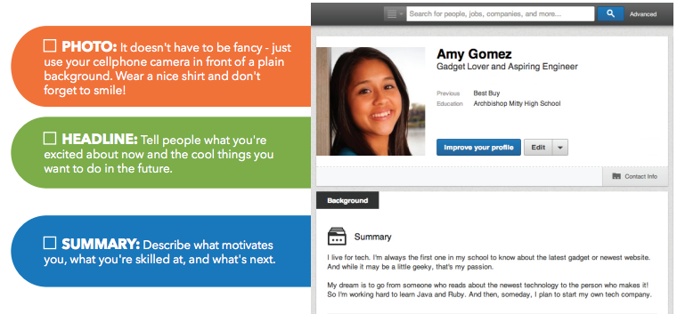
Professional Social Media Profile
Notes:
OPTIONAL
(15 Minutes)
Social media is becoming a very important tool and it will be discussed in relation to marketing later on. A professional social media profile is also an important tool much like a resume.
As students are preparing their nomination speeches, encourage them to reference the Professional Social Media Profile Checklist and videos in the JA Canada Digital Campus.
You may want to encourage students to build a profile and utilize it in their nomination presentation.
This is a good time to mention that later on when applying for employment students will be able to reference and leverage their JA experience therefore be sure to include it on resume and social media profiles under Organizations they have been involved with.
Mentors could consider displaying their own professional social media profile as examples.

Slide 143
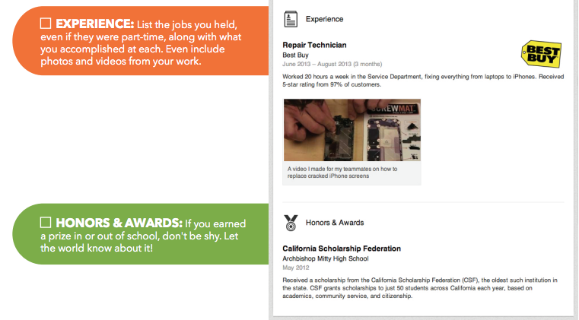
Professional Social Media Profile
Notes:
OPTIONAL

Slide 144
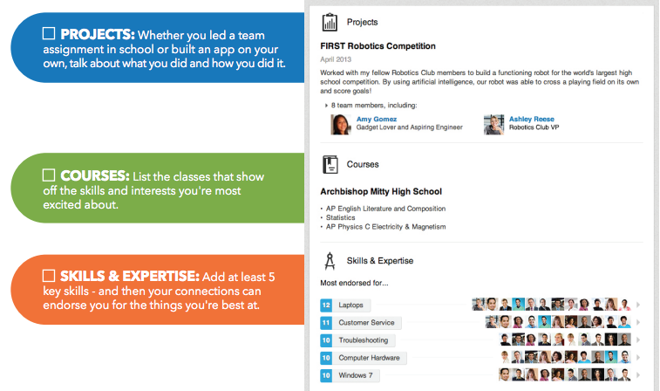
Professional Social Media Profile
Notes:
OPTIONAL

Slide 145
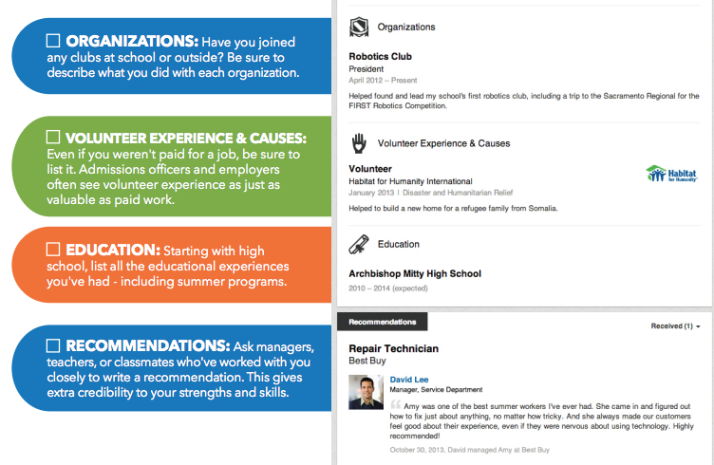
Professional Social Media Profile
Notes:
OPTIONAL

Slide 146
Questions & Next Steps
Ongoing business operations
Notes:
Wrap-up (5 min)
Create an opening to allow students to ask questions or provide feedback on how they are feeling to date.
Let students know that they will have an opportunity to continue planning next week with the goal of starting production no later then Week 7. If they are ready to begin next week they may do so.

Slide 147
PHASE 5
Achieve
Notes:
Phase 5 Achieve
Personal potential is realized when individuals take risks, engage in new experiences and collaborate with others, and celebrate the success achieved together.
Objectives
Understand the steps to close a business
Share learning outcomes and successes in a variety of formats
Conduct a final status meeting
Reflect, appraise, and submit feedback to improve program experience

Slide 148
Week 16
Company Meeting
Factors of Success
Review requirements described in the Final Report and Presentation Outline
Review Liquidating and Concluding Guidelines
Questions and wrap-up
Notes:
Week 16
This is the final week to receive sales income and by the end of this meeting all books and records should be finalized and closed.
Objectives
Understand the steps to close a business
Share learning outcomes and successes in a variety of formats.
Conduct a final shareholder meeting.
Reflect, appraise, and submit feedback to improve program experience.
Mentor Preparation
Review videos and materials in advance on the JA Canada Campus.
Print out a copy of the Final Report and Presentation Outline and Liquidating and Concluding Guidelines if online access is not possible.
Company Meeting (15 minutes)
Factors of Success (15 minutes)
Review requirements described in the Final Report and Presentation Outline (10 min)
Review Liquidating and Concluding Guidelines (75 min)
Questions and wrap-up (5 min)

Slide 149
Factors of Success
Notes:
Factors of Success (15 minutes)
Let the students know that in the next few weeks they will be closing their Company. As part of that process, you will be reviewing several of the requirements to do this.
Ask the group if they feel they have been successful?
This may illicit many responses. In some cases, Companies may be able to celebrate having made a profit. In other cases, they may not be on track or have reached their break-even point.
The point of the conversation is to encourage the group to look at the positive things they have done and accomplished.
Use this opportunity to bring back the SMART goals the students created in the Week 1. Remind students of the individual goals they had written and ask if anyone would like to share. Also refer to the company goals and discuss what they have achieved and learned.
Refer back to the 5 Stages of Team development, ask students to reflect on how they managed to move from Forming, Storming, Norming, Performing to Adjourning together. How was the journey to this point of the Company?
Ask students, if following a Code of Ethics/Test of Disclosure created a Company with JA values.
Now that the Company is in its final weeks, take some time to circle back to the Key Performance Indicators they had created. Take the opportunity to celebrate successes and look at any items that have not been achieved to determine if it’s still possible.
This activity will help students prepare for writing their final report.

Slide 150
Final Report Outline
The Final Report should include the following components in this order:
Title Page
Letter to the Shareholders
Table of Contents
Company Membership
Organizational Chart
Department Overview Letters
Summary of Financial Figures and Statements
Recognition of Outstanding Members/Directors
Acknowledgments
Final Report and Presentation Outline
Notes:
3. Review requirements described in the Final Report Outline (10 min)
Shareholders in JA Companies will want to know why their investment paid off or why the business failed to be profitable. Participants prepare a Final Report and Presentation to share their results with the people who made an investment.
Form a final report committee which will be chaired by either the VP HR or the VP Finance.
Each VP will have components to provide for this report as outlined in the Final Report and Presentation Outline.
Begin work on this report early using placeholders for any data that might not be ready.
Direct students to the JA Canada Campus for examples of final reports
You may wish to invite all shareholders to the meeting (usually this means the company members’ family and friends).

Slide 151
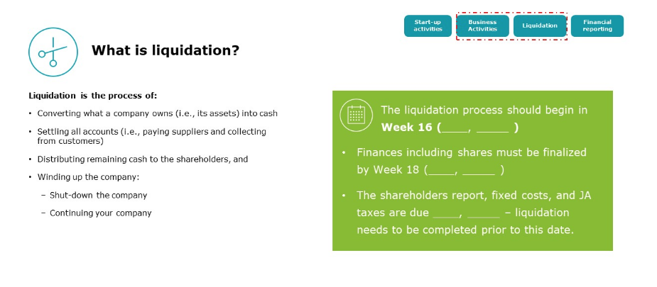
Liquidating and Concluding Guidelines
Liquidating and Concluding Guidelines
Notes:
3. Review requirements described in the Final Report Outline (10 min)
Shareholders in JA Companies will want to know why their investment paid off or why the business failed to be profitable. Participants prepare a Final Report and Presentation to share their results with the people who made an investment.
Form a final report committee which will be chaired by either the VP HR or the VP Finance.
Each VP will have components to provide for this report as outlined in the Final Report and Presentation Outline.
Begin work on this report early using placeholders for any data that might not be ready.
Direct students to the JA Canada Campus for examples of final reports
You may wish to invite all shareholders to the meeting (usually this means the company members’ family and friends).

Slide 152
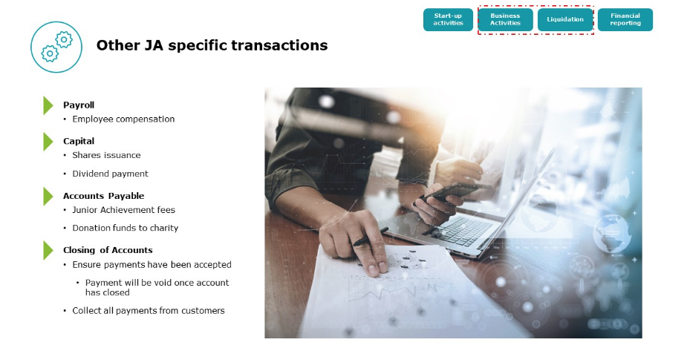
Liquidating and Concluding Guidelines
Notes:
3. Review requirements described in the Final Report Outline (10 min)
Shareholders in JA Companies will want to know why their investment paid off or why the business failed to be profitable. Participants prepare a Final Report and Presentation to share their results with the people who made an investment.
Form a final report committee which will be chaired by either the VP HR or the VP Finance.
Each VP will have components to provide for this report as outlined in the Final Report and Presentation Outline.
Begin work on this report early using placeholders for any data that might not be ready.
Direct students to the JA Canada Campus for examples of final reports
You may wish to invite all shareholders to the meeting (usually this means the company members’ family and friends).

Slide 153
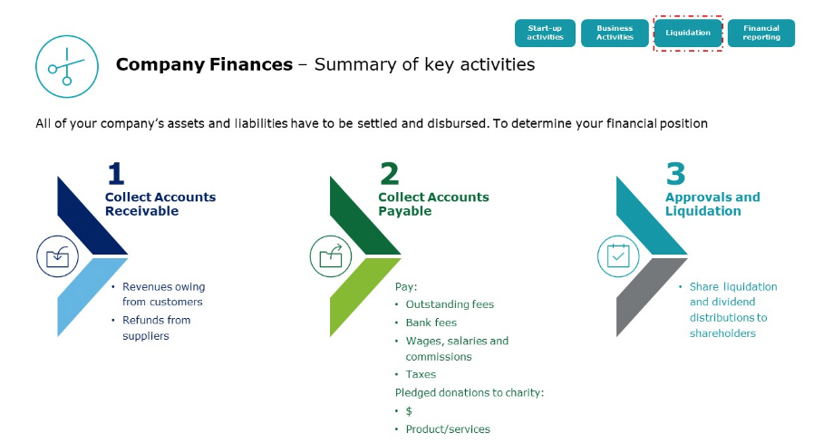
Liquidating and Concluding Guidelines
Notes:
3. Review requirements described in the Final Report Outline (10 min)
Shareholders in JA Companies will want to know why their investment paid off or why the business failed to be profitable. Participants prepare a Final Report and Presentation to share their results with the people who made an investment.
Form a final report committee which will be chaired by either the VP HR or the VP Finance.
Each VP will have components to provide for this report as outlined in the Final Report and Presentation Outline.
Begin work on this report early using placeholders for any data that might not be ready.
Direct students to the JA Canada Campus for examples of final reports
You may wish to invite all shareholders to the meeting (usually this means the company members’ family and friends).

Slide 154
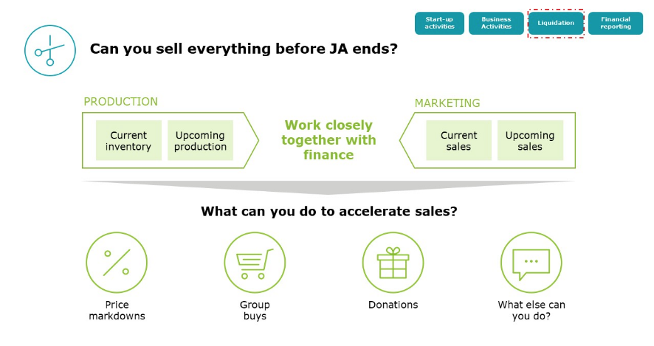
Liquidating and Concluding Guidelines
Notes:
3. Review requirements described in the Final Report Outline (10 min)
Shareholders in JA Companies will want to know why their investment paid off or why the business failed to be profitable. Participants prepare a Final Report and Presentation to share their results with the people who made an investment.
Form a final report committee which will be chaired by either the VP HR or the VP Finance.
Each VP will have components to provide for this report as outlined in the Final Report and Presentation Outline.
Begin work on this report early using placeholders for any data that might not be ready.
Direct students to the JA Canada Campus for examples of final reports
You may wish to invite all shareholders to the meeting (usually this means the company members’ family and friends).

Slide 155
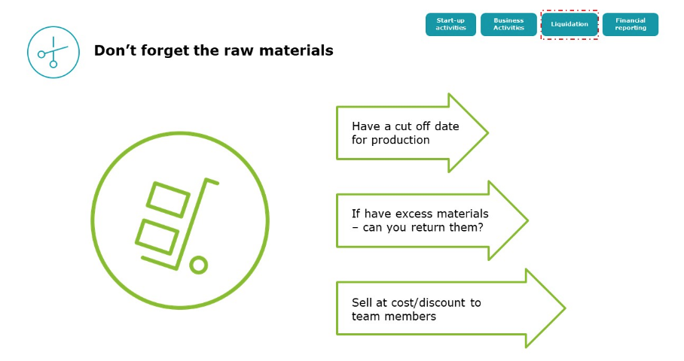
Liquidating and Concluding Guidelines
Notes:
3. Review requirements described in the Final Report Outline (10 min)
Shareholders in JA Companies will want to know why their investment paid off or why the business failed to be profitable. Participants prepare a Final Report and Presentation to share their results with the people who made an investment.
Form a final report committee which will be chaired by either the VP HR or the VP Finance.
Each VP will have components to provide for this report as outlined in the Final Report and Presentation Outline.
Begin work on this report early using placeholders for any data that might not be ready.
Direct students to the JA Canada Campus for examples of final reports
You may wish to invite all shareholders to the meeting (usually this means the company members’ family and friends).

Slide 156
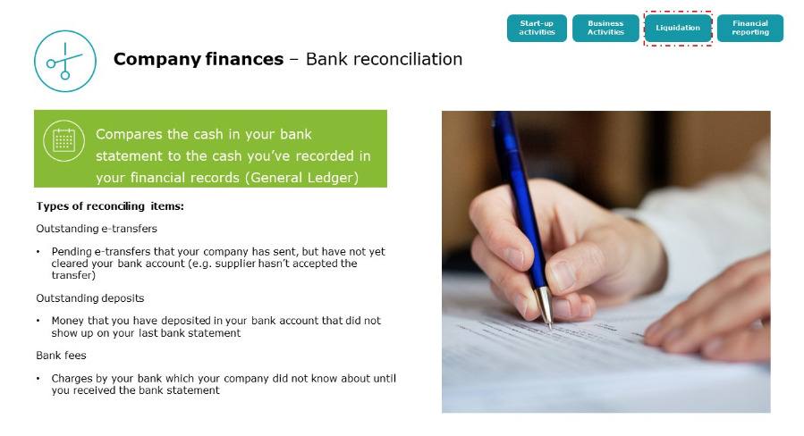
Liquidating and Concluding Guidelines
Notes:
3. Review requirements described in the Final Report Outline (10 min)
Shareholders in JA Companies will want to know why their investment paid off or why the business failed to be profitable. Participants prepare a Final Report and Presentation to share their results with the people who made an investment.
Form a final report committee which will be chaired by either the VP HR or the VP Finance.
Each VP will have components to provide for this report as outlined in the Final Report and Presentation Outline.
Begin work on this report early using placeholders for any data that might not be ready.
Direct students to the JA Canada Campus for examples of final reports
You may wish to invite all shareholders to the meeting (usually this means the company members’ family and friends).

Slide 157
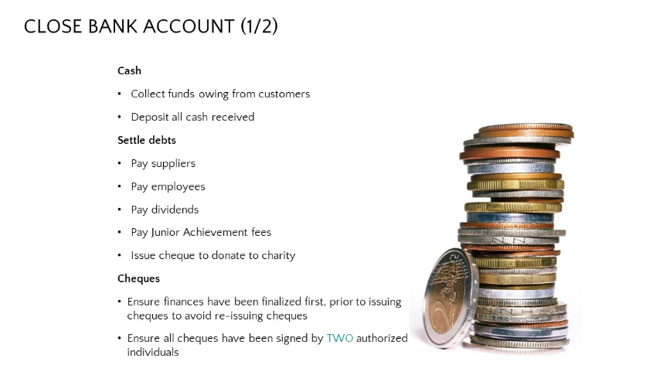
Liquidating and Concluding Guidelines
Notes:
3. Review requirements described in the Final Report Outline (10 min)
Shareholders in JA Companies will want to know why their investment paid off or why the business failed to be profitable. Participants prepare a Final Report and Presentation to share their results with the people who made an investment.
Form a final report committee which will be chaired by either the VP HR or the VP Finance.
Each VP will have components to provide for this report as outlined in the Final Report and Presentation Outline.
Begin work on this report early using placeholders for any data that might not be ready.
Direct students to the JA Canada Campus for examples of final reports
You may wish to invite all shareholders to the meeting (usually this means the company members’ family and friends).

Slide 158
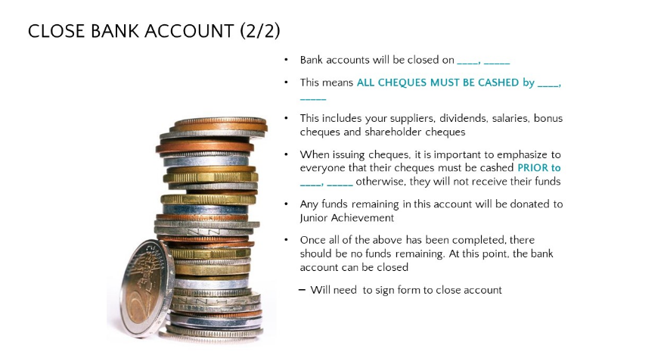
Liquidating and Concluding Guidelines
Notes:
3. Review requirements described in the Final Report Outline (10 min)
Shareholders in JA Companies will want to know why their investment paid off or why the business failed to be profitable. Participants prepare a Final Report and Presentation to share their results with the people who made an investment.
Form a final report committee which will be chaired by either the VP HR or the VP Finance.
Each VP will have components to provide for this report as outlined in the Final Report and Presentation Outline.
Begin work on this report early using placeholders for any data that might not be ready.
Direct students to the JA Canada Campus for examples of final reports
You may wish to invite all shareholders to the meeting (usually this means the company members’ family and friends).

Slide 159

Liquidating and Concluding Guidelines
Notes:
3. Review requirements described in the Final Report Outline (10 min)
Shareholders in JA Companies will want to know why their investment paid off or why the business failed to be profitable. Participants prepare a Final Report and Presentation to share their results with the people who made an investment.
Form a final report committee which will be chaired by either the VP HR or the VP Finance.
Each VP will have components to provide for this report as outlined in the Final Report and Presentation Outline.
Begin work on this report early using placeholders for any data that might not be ready.
Direct students to the JA Canada Campus for examples of final reports
You may wish to invite all shareholders to the meeting (usually this means the company members’ family and friends).

Slide 160
Management Team Check-In
How are you feeling? What are you experiencing?
How do you feel with the support you are receiving in your role?
On a scale of 1-10, how would you rate your team’s engagement?
Do you feel that all Company members are abiding by the Code of Ethics and applying the Test of Disclosure when needed?
Do you feel there is something else I (Mentor) or JA can do to support you or the Company overall?
Notes:
Management Team Check-in
During this Phase, Mentors are encouraged to conduct an informal management check-in between weeks 8-9. The members of the management team will have been in their roles for a few weeks and completed planning therefore it is time to check-in to see how they are feeling and if they are on task. This meeting offers an opportunity to provide constructive feedback, acknowledge efforts and provide some coaching as needed.
Consider guiding the conversation with the following questions:
How are you feeling? What are you experiencing?
How do you feel with the support you are receiving in your role?
On a scale of 1-10, how would you rate your team’s engagement?
Do you feel that all Company members are abiding by the Code of Ethics and applying the Test of Disclosure when needed?
Do you feel there is something else I (Mentor) or JA can do to support you or the Company overall?
At the same time, conduct an informal check-in with members from each department to see how they are feeling and if they have concerns about the company’s direction. If concerns or challenges arise during these check-ins, discuss them with your Program Manager to determine the best course of action.
Flexible Lessons Mentors may choose to deliver the two lessons below as mini-lessons during Week 8-10.

Slide 161
Questions & Next Steps
Complete any outstanding reports and prepare to respond to questions at the final meeting
Notes:
Wrap-up (5 min)
Create an opening to allow students to ask questions or provide feedback on how they are feeling to date.

Slide 162
Week 17
Company Meeting
Review Sample Meeting Agenda - Final Status Meeting
Finalize records, data, and compile reports
Final presentation run through
Wrap-up
Notes:
1. Company Meeting (10 min)
Allow the team to conduct their weekly team meeting and take attendance.
Review Sample Meeting Agenda - Final Status Meeting (20 min)
Review the Sample Meeting Agenda - Final Status Meeting
Allow time for the President to set their agenda for their Final Status Meeting and communicate/share it with the Company
Finalize records, data, and compile reports (50 min)
Provide support as students finalize their data entry and records.
Mentors should take time to review final records and ensure the Income Statement and Balance Sheet are completed properly.

Slide 163
Week 17
Final presentation run through
Notes:
1. Company Meeting (10 min)
Allow the team to conduct their weekly team meeting and take attendance.
Review Sample Meeting Agenda - Final Status Meeting (20 min)
Review the Sample Meeting Agenda - Final Status Meeting
Allow time for the President to set their agenda for their Final Status Meeting and communicate/share it with the Company
Finalize records, data, and compile reports (50 min)
Provide support as students finalize their data entry and records.
Mentors should take time to review final records and ensure the Income Statement and Balance Sheet are completed properly.

Slide 164
Management Team Check-In
How are you feeling? What are you experiencing?
How do you feel with the support you are receiving in your role?
On a scale of 1-10, how would you rate your team’s engagement?
Do you feel that all Company members are abiding by the Code of Ethics and applying the Test of Disclosure when needed?
Do you feel there is something else I (Mentor) or JA can do to support you or the Company overall?
Notes:
Management Team Check-in
During this Phase, Mentors are encouraged to conduct an informal management check-in between weeks 8-9. The members of the management team will have been in their roles for a few weeks and completed planning therefore it is time to check-in to see how they are feeling and if they are on task. This meeting offers an opportunity to provide constructive feedback, acknowledge efforts and provide some coaching as needed.
Consider guiding the conversation with the following questions:
How are you feeling? What are you experiencing?
How do you feel with the support you are receiving in your role?
On a scale of 1-10, how would you rate your team’s engagement?
Do you feel that all Company members are abiding by the Code of Ethics and applying the Test of Disclosure when needed?
Do you feel there is something else I (Mentor) or JA can do to support you or the Company overall?
At the same time, conduct an informal check-in with members from each department to see how they are feeling and if they have concerns about the company’s direction. If concerns or challenges arise during these check-ins, discuss them with your Program Manager to determine the best course of action.
Flexible Lessons Mentors may choose to deliver the two lessons below as mini-lessons during Week 8-10.

Slide 165
Questions & Next Steps
Complete Final Report and Presentation.
Notes:
Wrap-up (5 min)
Create an opening to allow students to ask questions or provide feedback on how they are feeling to date.

Slide 166
Week 18
Final Status Meeting
Debrief and Celebration
Wrap-Up
Notes:
Final Status meeting (50 min)
Debrief & Celebration (50 min)
Wrap-up (20 min)
Activities
1. Final Status Meeting and Presentation (50 min)
Allow the team to conduct the Final Status meeting
The President should lead the meeting with the assistance of the Vice-Presidents.
When the meeting is finished the participants can send the Final Reports, shareholders’ letters and dividend cheques in envelopes and mail them to shareholders who are not present. Follow any instructions from your Charter Program Manager.

Slide 167
Week 18
CONGRATULATIONS!!
What went well? Or not? And why?
What challenges did you encounter and how did you overcome them? Or not?
What would you do different?
Did the teamwork and communicate well together?
What part of the program was most valuable for you?
Did you achieve your personal goals?
Notes:
Debrief & Celebration (50 min)
Ask students to consider their personal and team goals that they set at the beginning of the program. Were these goals accomplished? What progress was made and what was learned along the way? The discussion should evaluate challenges faced but focus on successes achieved. Highlight the accomplishments of the team and the personal growth that they will take away from the experience. Questions to consider:
What went well? Or not? And why?
What challenges did you encounter and how did you overcome them? Or not?
What would you do different?
Did the team work and communicate well together?
What part of the program was most valuable for you?
Did you achieve your personal goals?
Ask students to consider how they will apply what they have learned.
Can they think of someone who might want to also want the JA Company Program experience? How would they share what they have learned?

